Slide 1
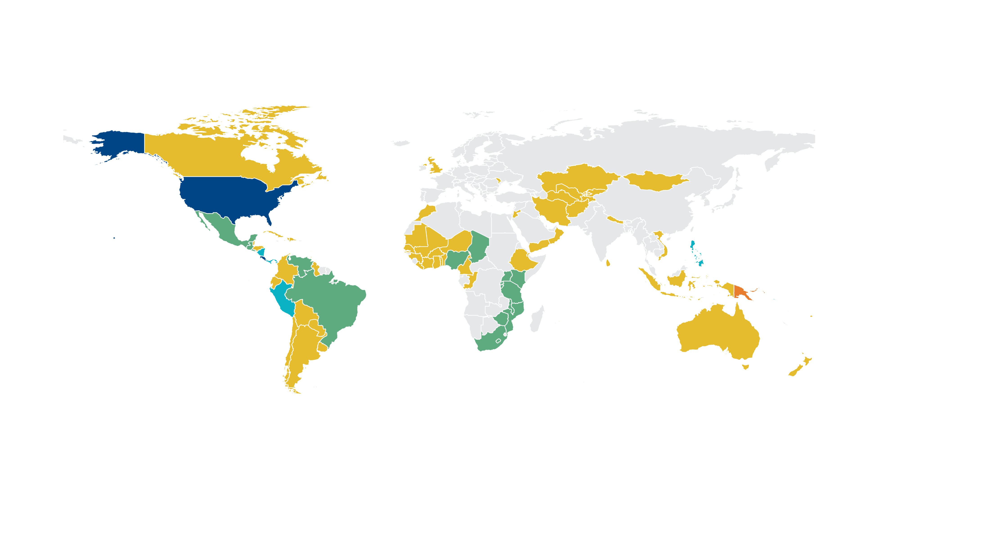

86 countries with legislation to fortify industrially milled flour and/or rice
Legislation in 85 countries mandates fortification of wheat flour alone or in combination with maize flour and/or rice.
One country (Papua New Guinea) has legislation to only fortify rice.
 | Wheat flour alone – 61 countries |  |  | Wheat flour and rice – 5 countries (Nicaragua, Panama, Peru, Philippines, Solomon Islands)
 | Rice alone – 1 country (Papua New Guinea) |  |  | Wheat flour, maize flour, and rice – 2 countries (Costa Rica and the United States)
 | Wheat flour and maize flour – 17 countries |  |  | No mandatory fortification legislation or data not available
Legislation has effect of mandating grain fortification with at least iron or folic acid. Legislation status from the Food Fortification Initiative (www.FFInetwork.org) August 2026.
Notes:
Countries fortify one or more industrially milled cereal grain products to improve the nutrient intake of people in their target audience. This map reflects wheat flour, maize flour, and rice fortification legislation.

