Slide 1
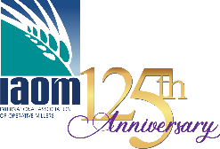
Technology Trends in Milling
Prepared by the Education Committee of the International Association of Operative Millers (IAOM)
Notes:
We’re going to take a short break from discussing wheat flour fortification monitoring. Dr. Wael Abbas, Minister Assistant for Investment and Logistics, Ministry of Supply and Internal Trade, suggested that we might spend a few minutes on the latest global trends in wheat flour milling since we have this room full of distinguished millers present. Special thanks to the Education Committee of the International Association of Operative Millers(IAOM) for putting this together.

Slide 2
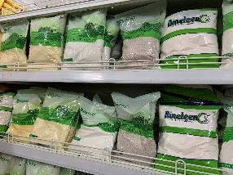


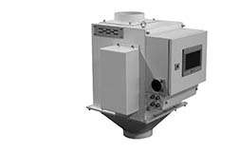
Trends in Today’s Milling Industry
Food Safety
Milling Technology
Notes:
Our world is changing and perhaps more rapidly than ever before. Social media and the 24-hour news cycle are influencing consumer behavior and employee’s expectations in the workplace. Machine digitization, the internet of things, and the impact of Coronavirus has driven the demand for automation to allow for fewer people in the workplace, and increased virtual work. Travel has been highly restricted, preventing members of corporate support staff, machinery vendor technicians and food safety auditors to travel to plants for troubleshooting and evaluation. We will discuss these trends for the next few minutes.
This presentation will focus on two broad categories including Food Safety and Milling Technology

Slide 3
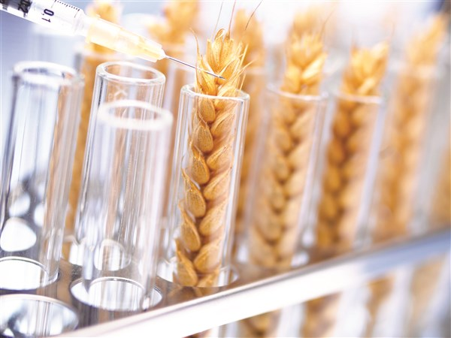
Trends – Food Safety
Reduce risk from Pathogen Microorganisms and Mycotoxins
Heat treatment for specialty flour
Wheat treatment for more widely used flours
Increased concern & requirements for testing and removal of allergens such as peanut residue and soy
Color sorters are becoming common place in the modern wheat cleaning system.
Increased requirements for product and raw material traceability
Notes:
In the last 5 years controlling pathogen microorganisms has become a strong focus in the milling industry. This is most applicable when the wheat flour does not go through a “kill” step in the baking process resulting in the pathogens being consumed by the ultimate consumer. Several millers have offered heat treated flour for specialty food production for many years, but due to cost and some impact on flour performance, the industry is seeking a means of more widespread wheat or flour treatment to combat the presence of pathogens. Treatment of temper water with chlorine or ozone are long standing efforts but have limited effectiveness (1 log reduction). More recently Latic Acid or Peracetic Acid are being used. These are more costly and pose some operational difficulties but offer a 2-4 log reduction. Due to allergen concerns, more testing and customer specifications are being seen around the presence of and peanut residue and soy in flour. As a result, color sorters – which were previously reserved for mills producing whole grain or durum products are becoming common place in the wheat-cleaning processes for mills that produce simple bakery flour.

Slide 4
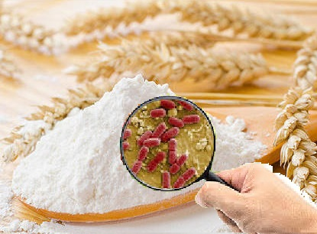
Food Safety – Foodborne Pathogens
Wheat-focused Strategies
Chlorine
Ozone
Lactic Acid
Peracetic Acid (PAA)
Notes:
The strategies that were developed to focus on wheat/or in the raw material included applying chlorine in temper for a < 1 log reduction. Studies suggest that the commercial application of ozone has lower efficacy than chlorination. Using a small percentage of lactic acid in temper water results in a 2-3 log reduction. Results for peracetic acid were similar to lactic acid when added to temper water – resulting in a 3-4 log reduction.

Slide 5
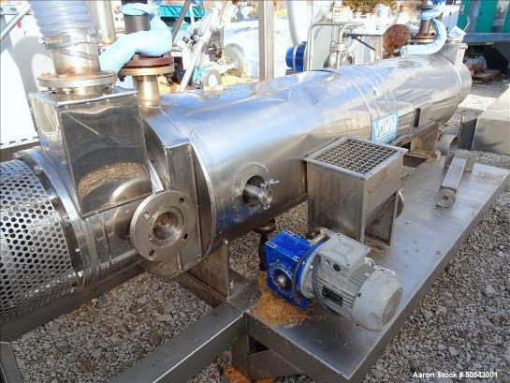
Food Safety – Foodborne Pathogens
Finished Product Strategies
Flour Performance
Heat Treatment
High-pressure Processing
Notes:
There is a heightened concern treating the finished product (flour) instead of wheat. This is because the treatment can have a negative impact on the flour performance or flour rheology, which impacts the end-user’s expectations. The heat treatment technologies are either macro-wave technologies or steam-jacketed conveyance. A third strategy is high-pressure processing, which has been known to alter protein and starch structures. This could modify the structure and properties of the starch-gluten matrix in flour post milling.
(https://www.sciencedirect.com/science/article/abs/pii/S0963996913002688#:~:text=High%2Dpressure%20processing%20(HPP),matrix%20in%20flour%20post%20milling.&text=Aggregation%20of%20gluten%20protein%20occurred%20at%20400,above%20for%20both%20moisture%20levels.)

Slide 6
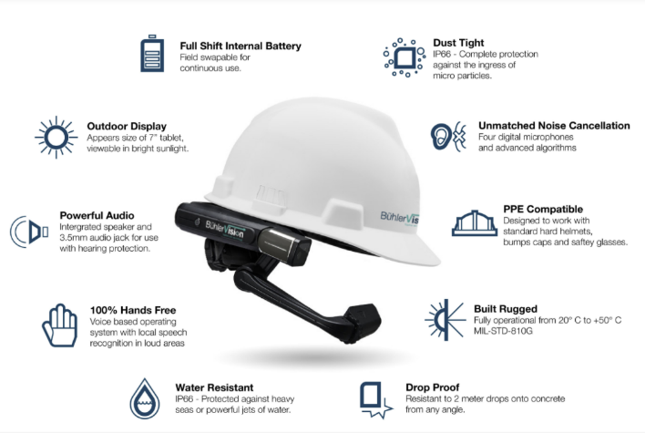
Trends – Technology
Digitization and technological advances are paving the way for remote troubleshooting by expert technicians.
Buhlervision
Notes:
Coronavirus related travel restrictions for both milling company support personnel and equipment vendors led to quick adaptation of remote troubleshooting, aided by machines with internet connectivity and tools such as Buhlervision.

Slide 7
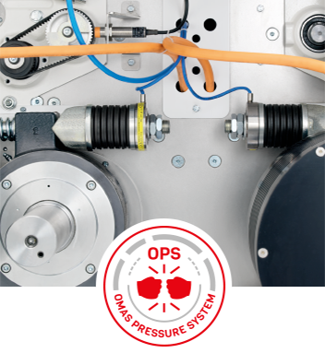
Trends – Milling Technology
Increased Automation and Data Analysis
Plant/machine Design
Energy Efficient/Sustainable Energy
Natural Gas Delivery Trucks, Electric Rail Switchyard Locomotives
Solar and Wind Generation
Regenerative
Omas Rollermill, Buhler and swisca Scales
Mechanical vs. Pneumatic
Notes:
Like cruise control on automobiles, mill automation has been around for a long time. But similarly, to how we are rapidly approaching the self driving car, millers are looking for technology to not only control and interlock all the machinery in the mill, but to also analyze data to adjust the milling process, troubleshoot faults and predict when machinery maintenance will be needed. Much of this data had been is coming into our control systems for years, what is new is capturing the data and then applying technology (software) to identify meaningful trends and analyze the data.
Due to increasing energy costs and the reality that governments will be taxing energy consumption (Carbon Taxes) has driven milling companies to invest in green energy – in some cases installing solar or wind power to provide part of the electricity consumed by the mill.
Others contract with power providers for “Green” electricity, where the green energy generating devices are owned and operated by the utility company, but the energy consumer can pay a premium to ear mark their electrical consumption from the “Green” source. Mill equipment manufactures are using technology to produce individual machines that are more energy efficient – in some cases using the physics of machine operation to regenerate electricity.
Buhler’s Mill E3 concept is a holistic approach to energy and economic savings starting with the mill design. Part of the E3 energy savings are gained through newfangled mechanical conveying systems, which replace energy heavy pneumatic conveying for certain milled stocks.

Slide 8
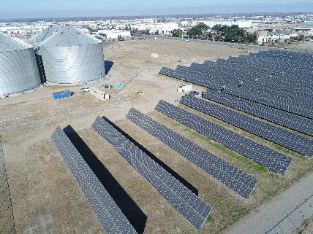
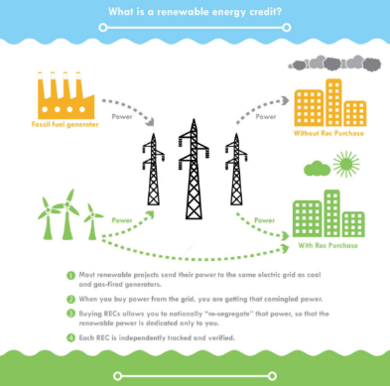
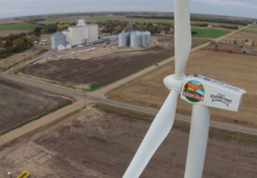
Trends – Milling Technology
Wind Power
Solar Power
Purchasing Green Energy (RECs)
Notes:
Left: Stafford County Mills in Kansas uses a single wind turbine to cost-effectively power its flour mill.
Middle Picture – Renewable Energy Credit. Most renewable projects send their power to the same electric grid as cool and gas-fired generators. When you buy power from the grid, you are getting that comingled power. Buying RECs allows you to notionally “re-segregate” that power, so that the renewable power is dedicated only to you. Each REC is independently tracked and verified.
Right Picture – 1 MGW solar array at Miller Milling Company in Fresno, California. This system will power approximately 15% of annual electric needs.

Slide 9
Trends – Milling Technology
Fewer Employees, More Automation
Less Plant Downtime for Maintenance
Larger mills are being designed to allow partial stoppages for maintenance
Machines designed for longer life and less maintenance
Internet connection, IoT and remote troubleshooting built into machine controls
Advanced tools allow for conditioned-based rather than time-based replacement
Roll corrugation measurement
Vibration and Ultrasonic analysis for bearings and mechanical power transmission
Infrared analysis of electrical components
Notes:
As mills become larger and more automated, there are fewer mill operators, performing maintenance on the mill has become more challenging.
Ocrim has been promoting their ability to design larger milling lines so that a portion of the mill machines can be stopped for maintenance while the mill continues to operate at reduced capacity.
A number of roll chill providers are offering flutes rolls with either a special coating or harder roll body material in order to extend the life of fluted rolls.
For several years more and more of the milling machines have been direct driven – by specialty gearmotors which eliminate the maintenance and energy loss associated with belt or chain power transmission.
As machines become more sophisticated, the ability for the local mill operator to troubleshoot and maintain is decreasing.
Internet connections for this type of machine are essential so that remotely located, skilled technicians can provide direction to those at the mill.

Slide 10
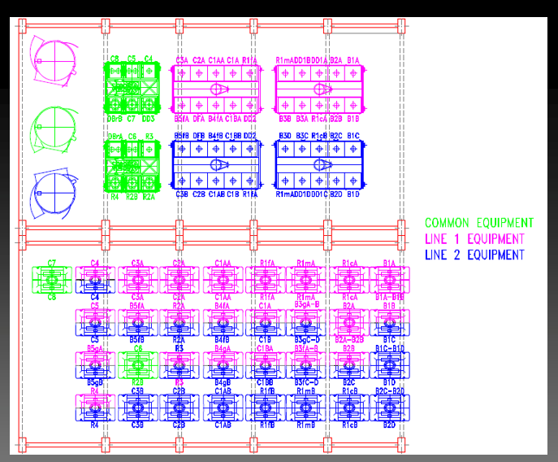

Trends – Milling Technology
Modular Milling Operation
Line 1 or Line 2 equipment can be stopped independently of each other for maintenance of the color-coded machines
Maintenance of the “Common Equipment” requires Lines 1 and 2 to be stopped
Notes:
Ocrim’s Modular Maintenance Operation allows for some machines to be stopped on a milling line designed with this feature, while the remaining machine continue to produce flour.
In the slide we can see the machines designated as line 1 can be stopped while line 2 continues to operate. The entire line only needs to be stopped for maintenance on the “common equipment.”

Slide 11
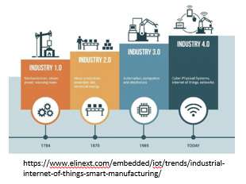
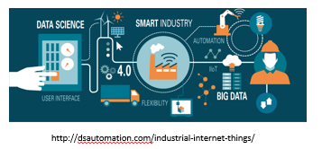
Trends – Milling Technology
Internet of Things (IoT)
Internet-connected objects (machines, sensors, database)
Network Securely within and across networks
Collect and Transfer Data
No human intervention - wireless and/or wired
Why Connect?
Defined specific not random purpose
Better manage inputs
Capital | Labor | Materials | Energy
Enhance return saving
Time | Money | Resources
Notes:
Millers and milling engineers will use IoT and the power of data collection and analysis to develop Artificial Intelligence (AI) to evolve more efficient grain conversion processes!

Slide 12
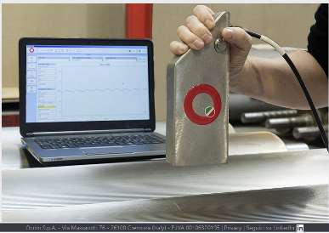
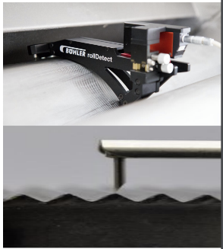
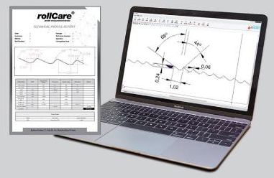
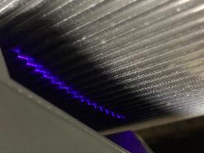
Trends – Milling Technology
Corrugation Tools
Ocrim’s Roll State Detector
Buhler Roll Detect
Yenar rollCare
OCRIM
Bühler
YENAR
Notes:
For years determining which rolls were dull and needed changing was the job of the Head Miller. By looking at the ground material discharging the roll while the mill is in operation and by examining the profile of the flutes while the mill is stopped, the Head Miller made judgement on which rolls needed to be changed, and which could continue to operate. If the miller was slow to identify and change dull rolls, mill yield and capacity are surely to suffer. If the miller is too quick to change rolls, the maintenance cost for roll corrugating is excessive and mill downtime for repairs is more than necessary. Whether the rolls are sharp or dull was the judgement of the head miller and rather subjective.
Mainline mill equipment manufactures are offering technology to subjectively measure the wear on the rollermill flutes. Ocrim’s system uses image analysis to evaluate the flute profile, while Buhler’s makes a mechanical tracing of the profile with a stylist. Yenar’s rollCare Profile Measurement Device uses high-resolution laser technology to check roll profiles (angles, depth, land, radius and pitch) while fluting and on the roller mills.
In all three systems, the measured flute profile is compared to the angles required by the diagram. Flute wear can then be objectively measured and roll re-fluting decisions can be made on data rather than touch and feel.

Slide 13
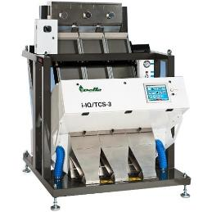
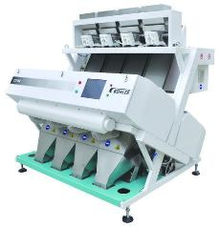
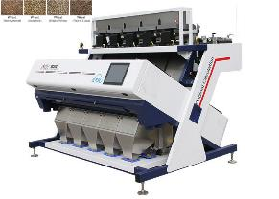
Trends – Milling Technology
Color Sorter
Color, Size, Shape Differentiation
Infrared and InGaAs Short-wave Infrared (SWIR) Cameras
Increased Efficiency
Decreased Air Consumption
Multi-functional
Decreased Operator Intervention
Notes:
The color sorter has revolutionized many aspects of cereal cleaning.
* Today’s machines offer not only color differentiation, but also size and shape differentiation.
* Color sorters with infra-red cameras (IR and InGaAs) allow deeper analysis of kernels, permitting differentiation on the basis of fungal contamination.
* Color sorters removal of stones allows to remove the traditional de-stoner and reducing the wheat stream to 3% for smaller efficient cleaner with a huge reduction un exhaust air consumption.
* Advancement of color sorters allow cereal cleaning to eliminate traditional cleaning flows such as, cylinders, disc separators and de-stoners saving reduction on air consumption, overall energy use and space requirements.
* Having short flow efficient cereal cleaning allows less operator intervention during the cleaning operations.

Slide 14
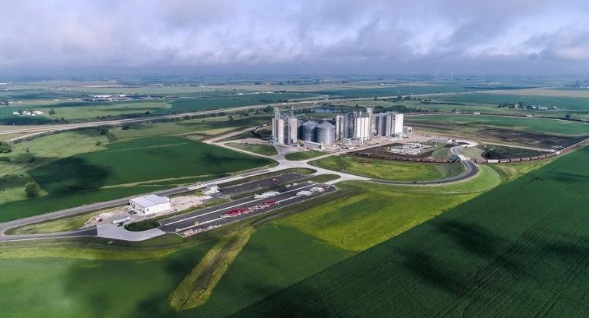
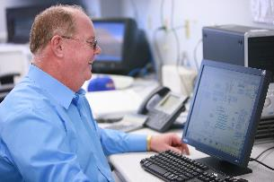
Trends – Conclusion
 ADM operates the largest flour mill in North America. Opened in 2019, it can produce 3 million pounds (1,360 MT) of flour a day, while employing just 30-40 people.
IoT allows mill machines and operations to be connected and monitored online.

Notes:
The world is changing rapidly through technology and some unexpected change has been brought forth by the pandemic.
As the world population increases, demand for food and energy will continue to increase. Millers will have to become more efficient and adapt technology to remain competitive.
Climate change regulation/activism will continue to make green energy options more commonplace.

