Slide 1
Folic acid fortification: The safe and effective action towards spina bifida prevention
Helena Pachón, PhD, MPH
Research Director
29th International Conference for Spina Bifida and Hydrocephalus
7 September 2022
Notes:
Good day.
Thank you to Dr Sylvia Roozen for inviting the Food Fortification Initiative to present on a public health intervention to prevent neural tube defects such as spina bifida.

Slide 2
Main messages
Fortifying food with folic acid is
Safe
Fortifying with folic acid does not
Mask vitamin B12 deficiency
Cause cancer or increase deaths from cancer
Cost-effective
Fortifying with folic acid
Reduces neural tube defects
Increase adenoma* risk
Costs less than treating neural tube defects
*Adenomas are benign tumors that can develop into cancer
Notes:
Through this presentation, I hope to convince you that
Fortifying food with folic acid is safe because it does not mask vitamin B12 deficiency, it does not increase the risk of developing adenomas, and it does not cause cancer or increase deaths from cancer.
Additionally, fortifying food with folic acid is effective because it reduces the risk of neural tube defects.
And it is cost-effective because it costs less than treatment of individuals with neural tube defects.

Slide 3



Foods fortified with folic acid
Folic acid in fortification standards
18 countries
80
countries
11
countries
https://fortificationdata.org/map-nutrient-levels-in-fortification-standards/
Notes:
80 countries include folic acid in their fortification standards for wheat flour, 18 do so for maize flour, and 11 for rice.

Slide 4



Foods fortified with folic acid
Research
Image
Image
Image
Tsang unpublished
Notes:
Researchers have added folic acid to other foods such as dairy products, salt and fruit juices.
--
Source:
Tsang BL, Stadnik C, Duong M, Pachon H, Martinez H. Expanding fortification with folic acid: thinking outside of the cereal-grain box. Unpublished manuscript.

Slide 5
Fortifying food with folic acid does not mask vitamin B12 deficiency
Notes:
Let’s start by reviewing evidence that fortifying food with folic acid does not mask vitamin B12 deficiency.

Slide 6
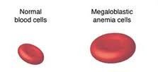
Folate and vitamin B12 deficiencies cause megaloblastic anemia
Folate deficiency
Vitamin B12 deficiency
Causes
Causes
Megaloblastic Anemia
IOM 2000
Megaloblastic anemia is the same as macrocytic anemia
Notes:
Folate deficiency independently causes megaloblastic anemia, that is anemia where the red blood cells are much larger than normal. Anemia is an important public health problem in many countries.
[CLICK TO ADVANCE] Vitamin B12 deficiency also independently causes megaloblastic anemia.
--
Source:
Institute of Medicine. Dietary Reference Intakes for Thiamin, Riboflavin, Niacin, Vitamin B6, Folate, Vitamin B12, Pantothenic Acid, Biotin, and Choline. 2000.
Megaloblastic anemia image: https://i.pinimg.com/236x/47/41/e6/4741e6ce99437a3260364ed6001b9ddf--macrocytic-anemia-b-deficiency.jpg

Slide 7
Folic acid masking of vitamin B12 deficiency
Megaloblastic anemia due to vitamin B12 deficiency only
If folic acid is provided
If vitamin B12 is not provided
Anemia is corrected
Vitamin B12 deficiency persists
“folic acid masking of vitamin B12 deficiency”
Berry 2019
Notes:
Let’s say a person has megaloblastic anemia due to vitamin B12 deficiency only. This is often observed in older adults because they no longer absorb vitamin B12 from the diet as well as they did when they were younger.
In these individuals, if folic acid is provided, the anemia is corrected.
[CLICK TO ADVANCE] However, if vitamin B12 is not provided to them, then their vitamin B12 deficiency can persist and with it, potentially irreversible neurological conditions such as memory loss, disorientation and frank dementia.
[CLICK TO ADVANCE] The fact that folic acid can correct megaloblastic anemia while not treating the underlying vitamin B12 deficiency is known as “folic acid masking of vitamin B12 deficiency.”
--
Source:
RJ Berry. Lack of historical evidence to support folic acid exacerbation of the neuropathy caused by vitamin B12 deficiency. American Journal of Clinical Nutrition 2019.

Slide 8
Study to assess if fortification with folic acid causes masking of vitamin B12 deficiency
People with vitamin B12 deficiency and no anemia who consume food fortified with folic acid
Folic acid is provided
Vitamin B12 is not provided
Anemia does not develop
Vitamin B12 deficiency develops
Mills 2003, Qi 2014
Notes:
In two studies conducted in the USA, researchers surmised that people with vitamin B12 deficiency and no anemia who consumed food fortified with folic acid could be at risk of vitamin B12 deficiency going untreated.
In other words, in these individuals, since folic acid is provided through fortification in the USA, they will not develop anemia.
However, since vitamin B12 is not provided through fortification in the USA, their vitamin B12 deficiency will persist.
--
Source:
Mills JL et al. Low vitamin B-12 concentrations in patients without anemia: the effect of folic acid fortification of grain. Am J Clin Nutr 2003;77:1474–7.
Yan Ping Qi, Ann N. Do, Heather C. Hamner, Christine M. Pfeiffer, and Robert J. Berry. The prevalence of low serum vitamin B-12 status in the absence of anemia or macrocytosis did not increase among older U.S. adults after mandatory folic acid fortification. J. Nutr. 144: 170–176, 2014.

Slide 9
Fortification with folic acid does not mask vitamin B12 deficiency
People with vitamin B12 deficiency and no anemia who consume food fortified with folic acid
Folic acid is provided
Vitamin B12 is not provided
Anemia does not develop
Vitamin B12 deficiency develops
If fortification with folic acid masks vitamin B12 deficiency, the percentage of individuals with both of these conditions should increase after fortification with folic acid
Study | Pre-fortification | Post-fortification | Conclusion
Mills 2003 | 39.2% | 37.6% | No masking of vitamin B12 deficiency
Qi 2014 | 4.0% | 3.9% | No masking of vitamin B12 deficiency
Mills 2003, Qi 2014
Notes:
If fortification with folic acid masks vitamin B12 deficiency, the percentage of people with vitamin B12 deficiency but no anemia should increase after fortification starts.
[CLICK TO ADVANCE] Two studies from the United States show the contrary—the prevalence of individuals with vitamin B12 deficiency and no anemia, did not change between the pre- and post-fortification periods, suggesting that fortification with folic acid does not mask vitamin B12 deficiency.
--
Source:
Mills JL et al. Low vitamin B-12 concentrations in patients without anemia: the effect of folic acid fortification of grain. Am J Clin Nutr 2003;77:1474–7.
Yan Ping Qi, Ann N. Do, Heather C. Hamner, Christine M. Pfeiffer, and Robert J. Berry. The prevalence of low serum vitamin B-12 status in the absence of anemia or macrocytosis did not increase among older U.S. adults after mandatory folic acid fortification. J. Nutr. 144: 170–176, 2014.

Slide 10
Free folic acid in the blood does not increase adenoma risk
Adenomas are benign tumors that can develop into cancer
“Free folic acid” is also referred to as “unmetabolized folic acid”
Notes:
Next we will review evidence that free folic acid in the blood does not increase the risk of adenomas.

Slide 11
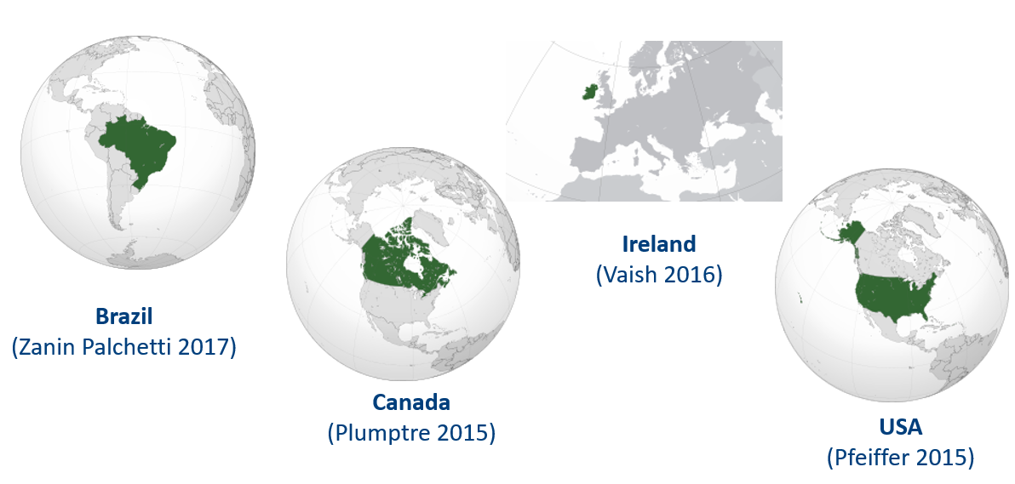
After folic acid consumption, free folic acid appears in the blood
“Free folic acid” is also referred to as “unmetabolized folic acid”
Notes:
Evidence from several countries with mandatory or voluntary food fortification with folic acid shows that free folic acid appears in the blood after folic acid consumption.
This has been observed, for example, in Brazil, Canada, Ireland and the USA.
--
Source:
Bailey R et al. Unmetabolized serum folic acid and its relation to folic acid intake from diet and supplements in a nationally representative sample of adults aged >60 y in the United States. Am J Clin Nutr 2010;92:383–9.
Boilson A et al. Unmetabolized folic acid prevalence is widespread in the older Irish population despite the lack of a mandatory fortification program. Am J Clin Nutr 2012; doi: 10.3945/ajcn.111.026633
Pfeiffer CM et al. Unmetabolized Folic Acid Is Detected in Nearly All Serum Samples from US Children, Adolescents, and Adults. J Nutr 2015;145:520–31.
Plumptre L et al. High concentrations of folate and unmetabolized folic acid in a cohort of pregnant Canadian women and umbilical cord blood. Am J Clin Nutr 2015;102:848–57.
Vaish 2016 et al. Synthetic folic acid intakes and status in children living in Ireland exposed to voluntary fortification. Am J Clin Nutr 2016;103:512–8.
Zanin Palchetti C et al. Association between Serum Unmetabolized Folic Acid Concentrations and Folic Acid from Fortified Foods. JOURNAL OF THE AMERICAN COLLEGE OF NUTRITION 2017, VOL. 36, NO. 7, 572–578. [Study conducted in Brazil].
Source for maps: wikipedia

Slide 12
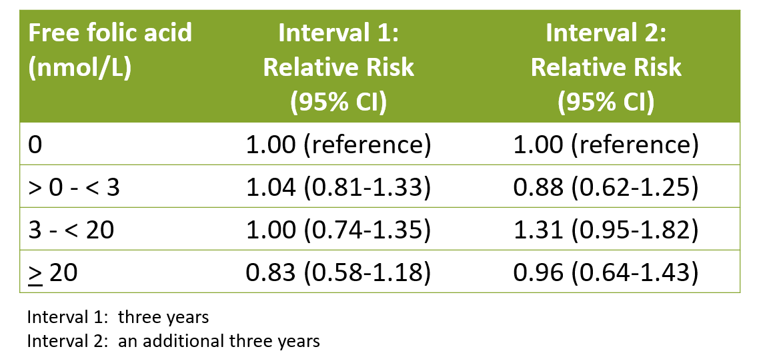
Free folic acid does not increase the risk of adenomas
Adenomas are benign tumors that can develop into cancer
“Free folic acid” is also referred to as “unmetabolized folic acid”
Rees 2017
Notes:
This study examined if there was a relationship between free folic acid in blood and the risk of getting colorectal adenomas, which are benign tumors that can develop into cancer.
Study participants were followed for two periods: interval one which was three years long and interval two which was an additional three years.
In the first column, they divided up the free folic acid levels in blood into four categories ranging from 0 nanomoles per liter to 20 nanomoles per liter or greater.
They then calculated the relative risk to determine if there was any relationship between free folic acid levels in blood and the risk of developing adenomas.
For intervals 1 and 2, all of the relative risks with their 95% confidence intervals include 1. This means that free folic acid levels in blood do not increase the risk of adenomas.
--
Source:
Rees JR et al. Unmetabolized Folic Acid, Tetrahydrofolate, and Colorectal Adenoma Risk. Cancer Prev Res; 10(8); 451–8. 2017.

Slide 13
Fortifying food with folic acid does not cause cancer or increase deaths from cancer
Notes:
Now, let’s review evidence that fortifying food with folic acid does not cause cancer or increase deaths from cancer.

Slide 14
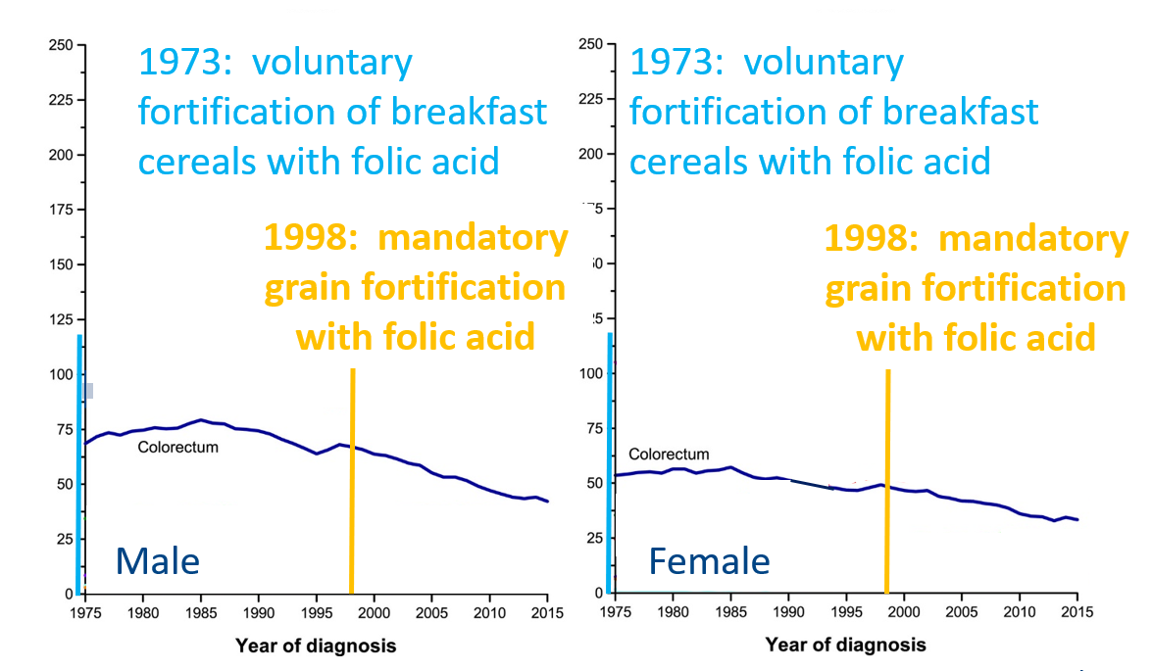
Fortification with folic acid does not cause cancer
Colorectal Cancer Rate per 100,000 Population, USA
Siegel 2019
Notes:
Here we have two graphs with the rate of colorectal cancer per 100,000 population in the United States. As you can see in the horizontal axes, the year of cancer diagnosis ranges from 1975 to 2015.
During this period, voluntary fortification of breakfast cereals with folic acid began in 1973 and mandatory fortification of grains with folic acid became effective in 1998.
The left-hand side has the data for males and the right-hand side has the data for females.
For both women and men, the dark blue line shows a reduction in the number diagnosed with colorectal cancer during this period.
There is no evidence that fortification with folic acid increases the number of people being diagnosed with colorectal cancer.
--
Source:
Siegel R et al. Cancer statistics, 2019. CA: A Cancer Journal for Clinicians. 2019.

Slide 15
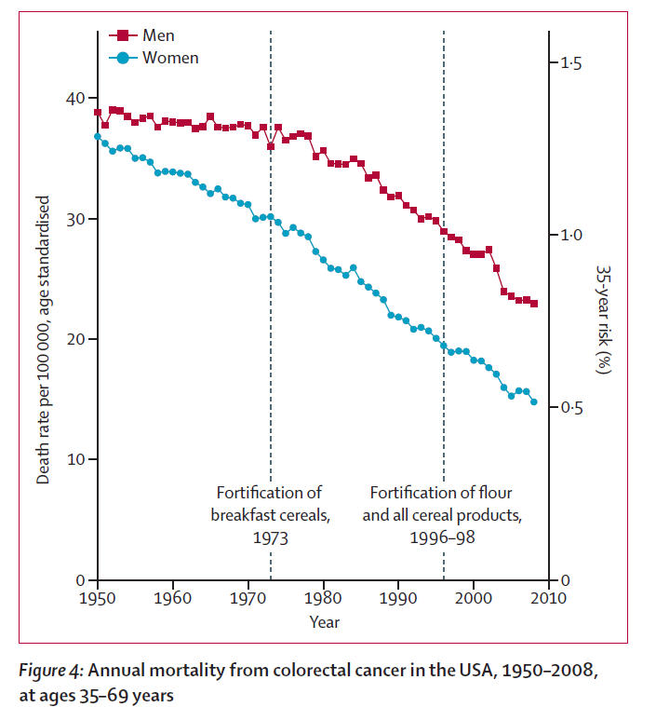
Fortification with folic acid does not increase deaths from cancer
Vollset 2013
Notes:
A related question is whether more people are dying from colorectal cancer due to fortification with folic acid.
Researchers reviewed data on the annual mortality in the United States from colorectal cancer from 1950 to 2010, which is the timeline that appears along the horizontal axis. They note in the dashed vertical lines that voluntary fortification of breakfast cereals began in 1973 and that mandatory flour fortification with folic acid became effective in 1998.
The data are presented for men in red and women in blue.
For both women and men, there was a decrease in annual deaths from colorectal cancer over this 60-year period.
These data suggest that folic-acid fortification does not increase deaths from colorectal cancer.
--
Source:
Vollset SE et al. Effects of folic acid supplementation on overall and site-specific cancer incidence during the randomised trials: meta-analyses of data on 50 000 individuals. Lancet January 25, 2012. http://dx.doi.org/10.1016/S0140-6736(12)62001-7.

Slide 16
Fortifying food with folic acid reduces the risk of neural tube defects and is cost-effective
Notes:
To close, I will present data that fortification with folic acid reduces the risk of neural tube defects and is cost-effective.

Slide 17
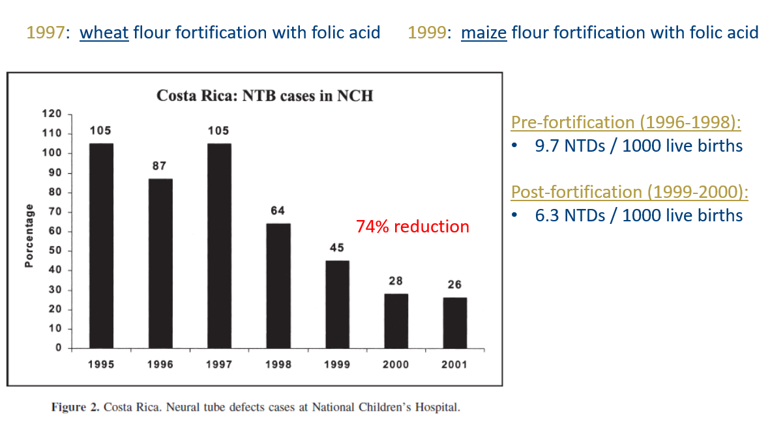
Fortification with folic acid reduces the risk of neural tube defects: Costa Rica
Tacsan Chen 2004
Notes:
Costa Rica began mandatory wheat flour fortification with folic acid and other nutrients in 1997 and the same for maize flour in 1999.
This graph shows the number of neural tube defect cases reported at the National Children’s Hospital between 1995 and 2001. We can observe the downward trend in cases, representing a 74% reduction through fortification with folic acid.
--
Source:
Luis Tacsan Chen & Melany Ascencio Rivera. The Costa Rican Experience: Reduction of Neural Tube Defects following Food Fortification Programs. Nutrition Reviews. 2004.

Slide 18
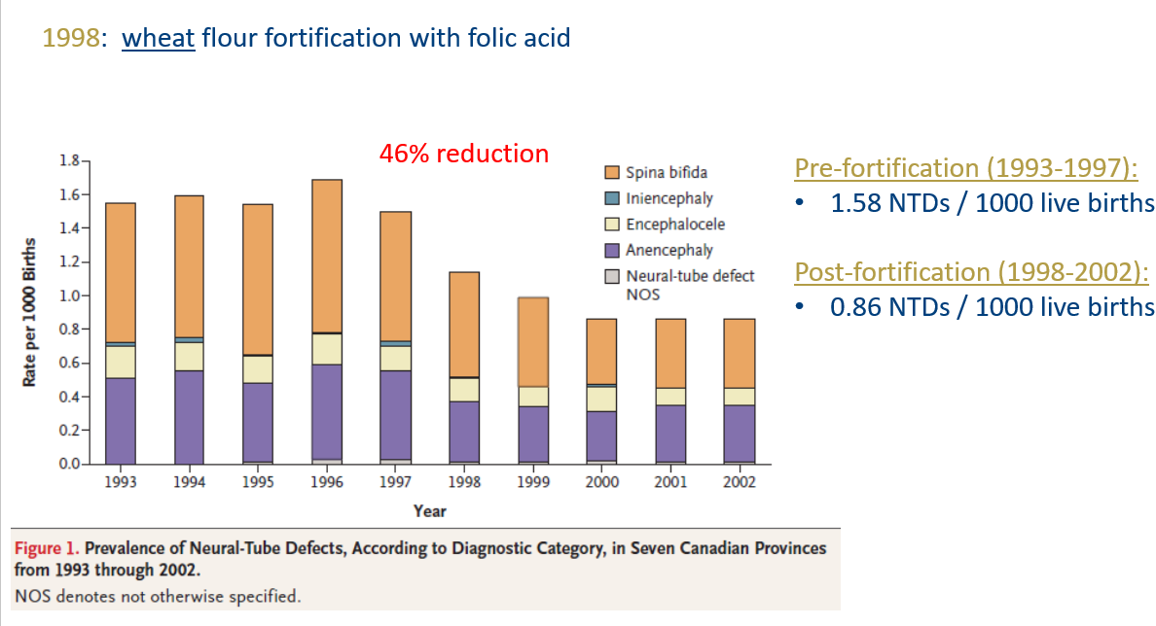
Fortification with folic acid reduces the risk of neural tube defects: Canada
De Wals 2007
Notes:
Canada mandated wheat flour fortification with folic acid and other nutrients to begin in 1998.
This graph shows the prevalence per 1000 births of babies with different neural tube defects. For example, orange represents spina bifida and purple represents anencephaly. The height of each bar represents the total number of neural tube defects per 1000 births.
Between 1993 and 2002, there was a 46% reduction in neural tube defects because of fortification with folic acid.
--
Source:
Philippe De Wals et al. Reduction in Neural-Tube Defects after Folic Acid Fortification in Canada. N Engl J Med 2007;357:135-42.

Slide 19
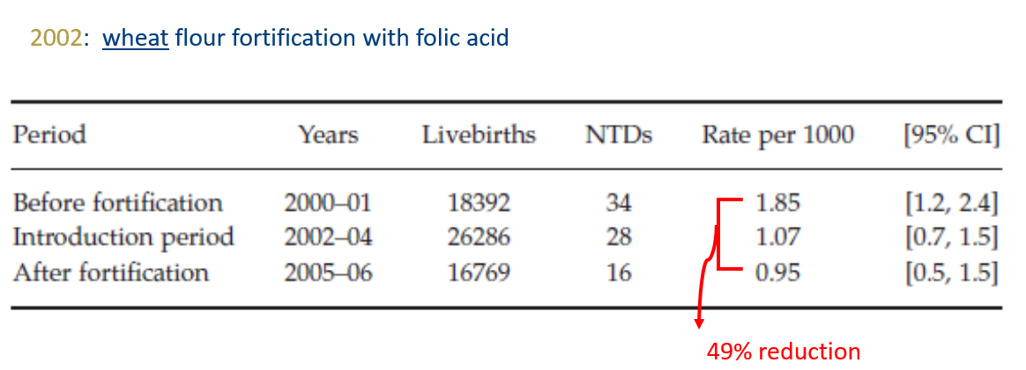
Fortification with folic acid reduces the risk of neural tube defects: Jordan
Amarin 2010
Notes:
Jordan began mandatory fortification of wheat flour with folic acid and other nutrients in 2002.
Researchers reported neural tube defects for three time periods: before fortification, during the early years of fortification (that is, the “introduction period”), and after several years of fortification (called “after fortification”).
Neural tube defects were reduced 49% through fortification with folic acid.
--
Source:
Amarin, Zouhair O., and Ahmed Z. Obeidat. "Effect of folic acid fortification on the incidence of neural tube defects." Paediatric and perinatal epidemiology 24.4 (2010): 349-351.

Slide 20
Fortification with folic acid reduces the risk of neural tube defects: meta-analysis
All Neural Tube Defects
Odds Ratio: 0.59 (95% CI: 0.49, 0.70)
n=19,816,008 births (reported in 8 studies)
41% reduction in the odds of neural tube defects after fortification with folic acid
Keats 2019
Notes:
Keats and colleagues summarized eight studies like the previous ones, with almost 20 million births, and found a 41% reduction in the odds of neural tube defects after fortification with folic acid.
--
Source:
Keats EC, Neufeld LM, Garrett GS, Mbuya MNN, Bhutta ZA. Improved micronutrient status and health outcomes in low- and middle-income countries following large-scale fortification: evidence from a systematic review and meta-analysis. Am J Clin Nutr. 2019 Jun 1;109(6):1696-1708.

Slide 21
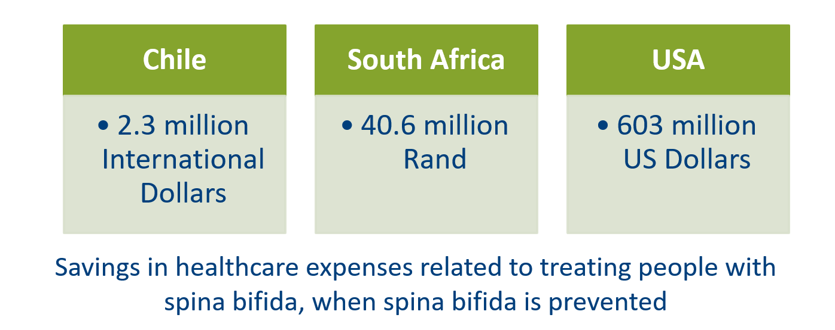
Fortification with folic acid is cost-effective in reducing the risk of neural tube defects
Annual Net Savings from Adding Folic Acid to Flour
Llanos 2007, Sayed 2008, Grosse 2016
Notes:
Three countries have compared the costs of adding folic acid to flour with the costs of treating people with spina bifida.
Each study showed significant net savings in healthcare expenses when spina bifida is prevented: 2.3 million international dollars in Chile, 40.6 million Rand in South Africa and 603 million US dollars in the USA.
Notice that these are annual savings, so every year of fortification leads to these net savings.
--
Source:
Llanos et. al., Cost-effectiveness of a Folic Acid Fortification Program in Chile. Health Policy 83 2007:295-303.
Sayed et.al., Decline in the Prevalence of Neural Tube Defects Following Folic Acid Fortification and Its Cost-Benefit in South Africa. Birth Defects Research 82 2008:211-216.
Grosse et. al., Retrospective Assessment of Cost Savings From Prevention. American Journal of Preventive Medicine , 2016.

Slide 22
Main messages
Fortifying food with folic acid is
Safe
Fortifying with folic acid does not
Mask vitamin B12 deficiency
Cause cancer or increase deaths from cancer
Cost-effective
Fortifying with folic acid
Reduces neural tube defects
Increase adenoma* risk
Costs less than treating neural tube defects
*Adenomas are benign tumors that can develop into cancer
Notes:
Through this presentation, I hope to have convinced you that
Fortifying food with folic acid is safe because it does not mask vitamin B12 deficiency, it does not increase the risk of developing adenomas, and it does not cause cancer or increase deaths from cancer.
Additionally, fortifying food with folic acid is effective because it reduces the risk of neural tube defects.
And it is cost-effective because it costs less than treatment of individuals with neural tube defects.

Slide 23


For more information:
www.FFInetwork.org
www.Facebook.com/FFInetwork
https://twitter.com/FFINetwork
Join the Food Fortification Initiative group on Linked In
Contact:
Helena.Pachon@emory.edu
SMARTER
STRONGER
HEALTHIER
Notes:
Thank you.

