Slide 1


Smarter Futures: a Public-Private-Civic Partnership
29th International Conference for
Spina Bifida and Hydrocephalus
7 September 2022
Scott Montgomery
Director, Food Fortification Initiative
Notes:
Thank you for the introduction. I’m Jessie Genoway, Communications Director for the Food Fortification Initiative, also known as FFI. I’ll be presenting today on behalf of Scott Montgomery, FFI’s Director.
At FFI, our mission is to prevent vitamin and mineral deficiencies and their consequences, like neural tube defects, by helping countries fortify commonly consumed staple grains. We have programs around the world, but most of our work in Africa has been through a 15-year-old partnership called Smarter Futures. Today, I’m going to go through a little more on this program and its many accomplishments.
Next slide please.

Slide 2
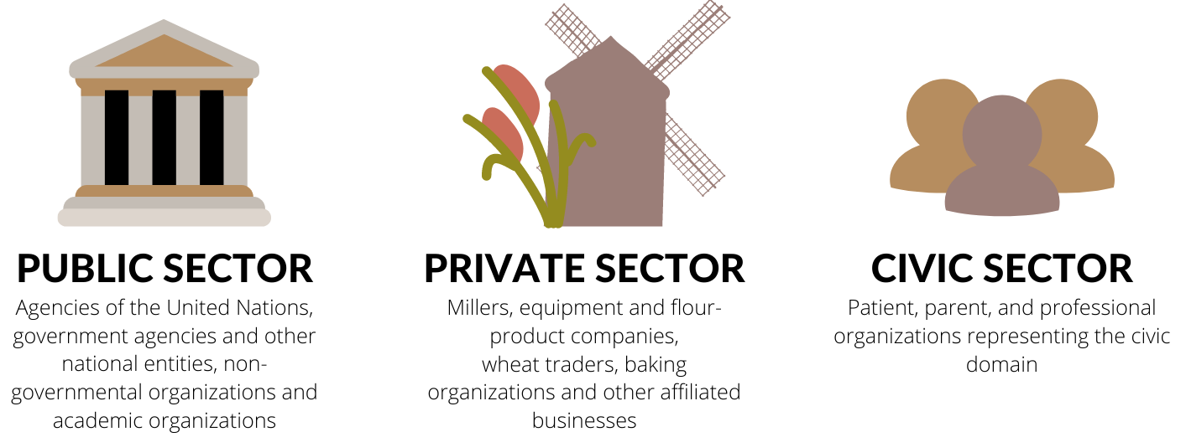
Unique Partnership Model
Notes:
From 2007-2021, Smarter Futures was a unique public-private-civic partnership that supported flour millers, governments, vitamin and mineral suppliers, international organizations, and academic institutions to make fortification of staple grains a reality in Africa.
The aim of Smarter Futures was to improve health by preventing vitamin and mineral deficiencies and their debilitating consequences, which include neural tube birth defects, but also impaired learning capacity, and decreased productivity just to name a few.
You’ve heard a lot about food fortification today but I wanted to reiterate just how powerful fortification is and continues to be in the countries where Smarter Futures helped build and strengthen fortification programs. Fortification delivers essential nutrients through inexpensive, shelf-stable foods that most people consume every day and it does not require consumers to change their eating or buying habits. Smarter Futures used fortification to address micronutrient deficiencies because of its strengths as an economically viable, cost-effective, food systems approach.
Though everybody benefits from fortification, the key groups to benefit through the Smarter Futures program are women of childbearing age, adolescents (especially girls), and young children. Additional nutrients, especially iron and folic acid, make these groups in particular smarter, stronger, and healthier.
Next slide please.

Slide 3
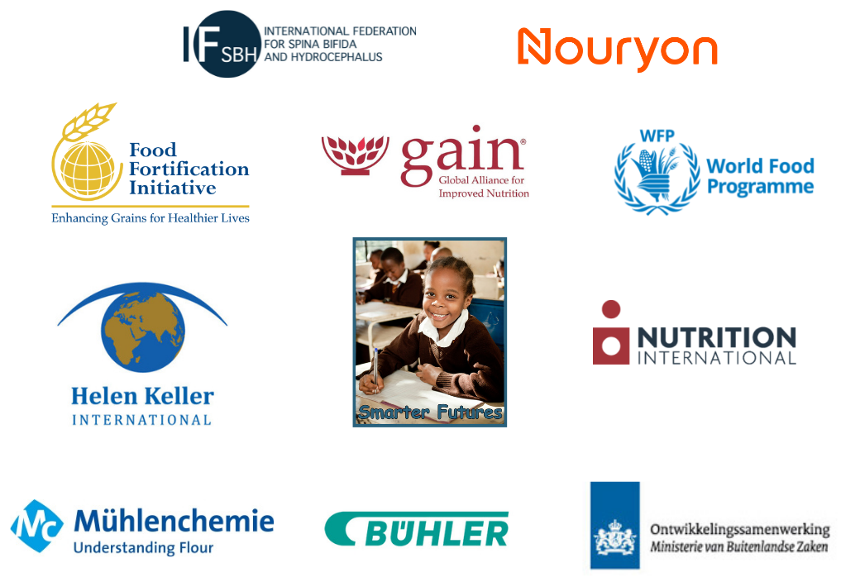
Partners
Notes:
As I mentioned before, the project included public, private, and civic partners.
The international advocacy and implementation partners involved were:
The Food Fortification Initiative as the umbrella partner to carryout activities.
The International Federation for Spina Bifida and Hydrocephalus (IF)
Global Alliance for Improved Nutrition
Helen Keller International
Nutrition International
And World Food Programme
Our Private sector partners included
Buhler
Muhlenchemie
And Nouryon
And lastly, a public sector partner,
The Ministry of Foreign Affairs of the Netherlands, supported the Partnership through a co-financing agreement.
Millers were key actors in this program—because, of course, without millers, there would be no flour fortification. Governments were also key—they enabled fortification through a supportive regulatory environment. We aimed to build capacity in these networks and provided technical support and training.
Smarter Futures did not itself invest large program resources but supported and strengthened the efforts of the network partners I mentioned.
Next slide please.

Slide 4
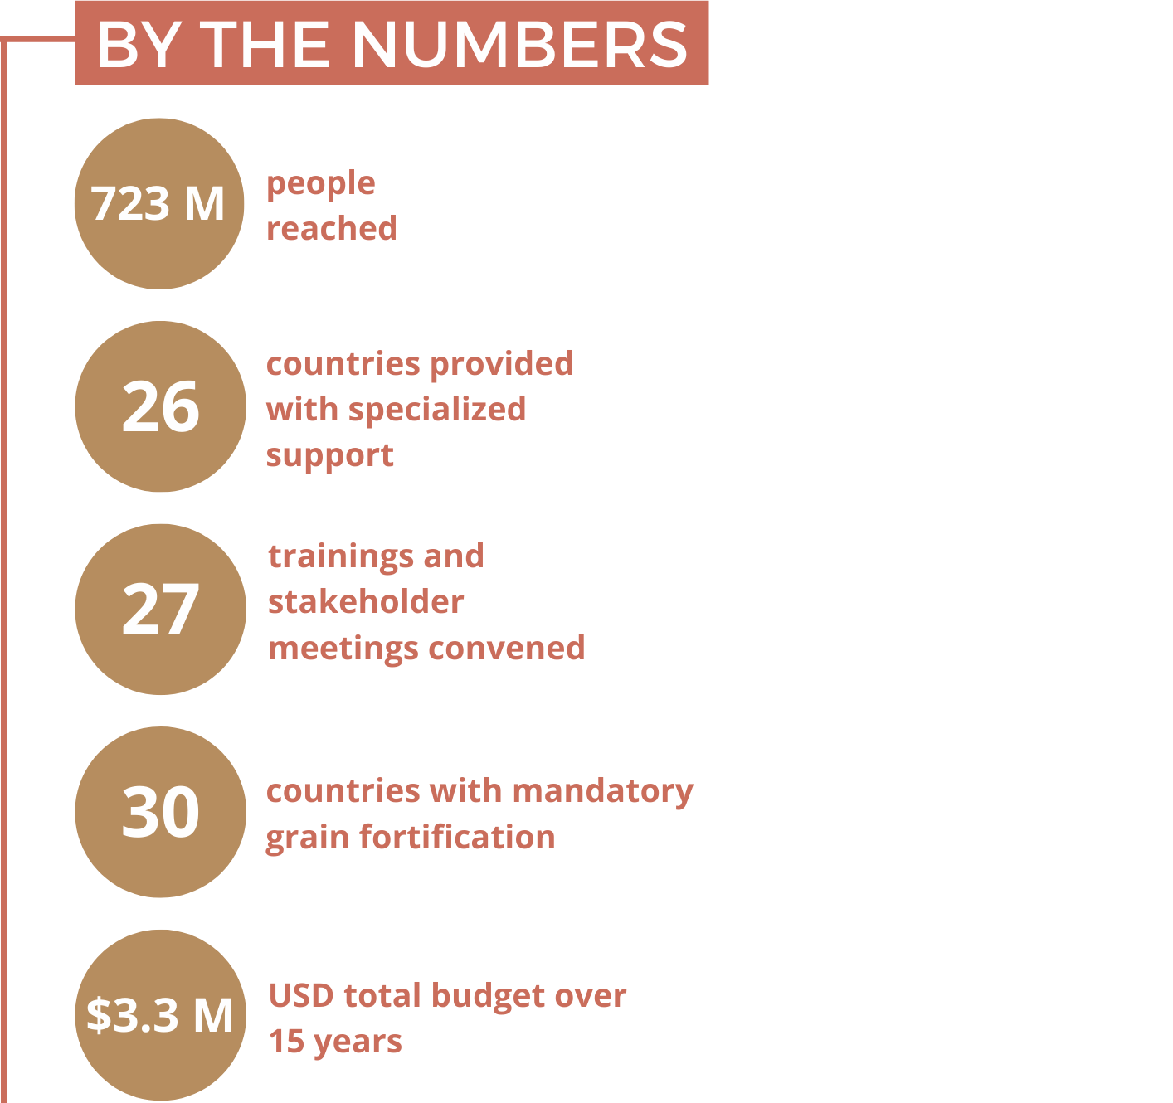
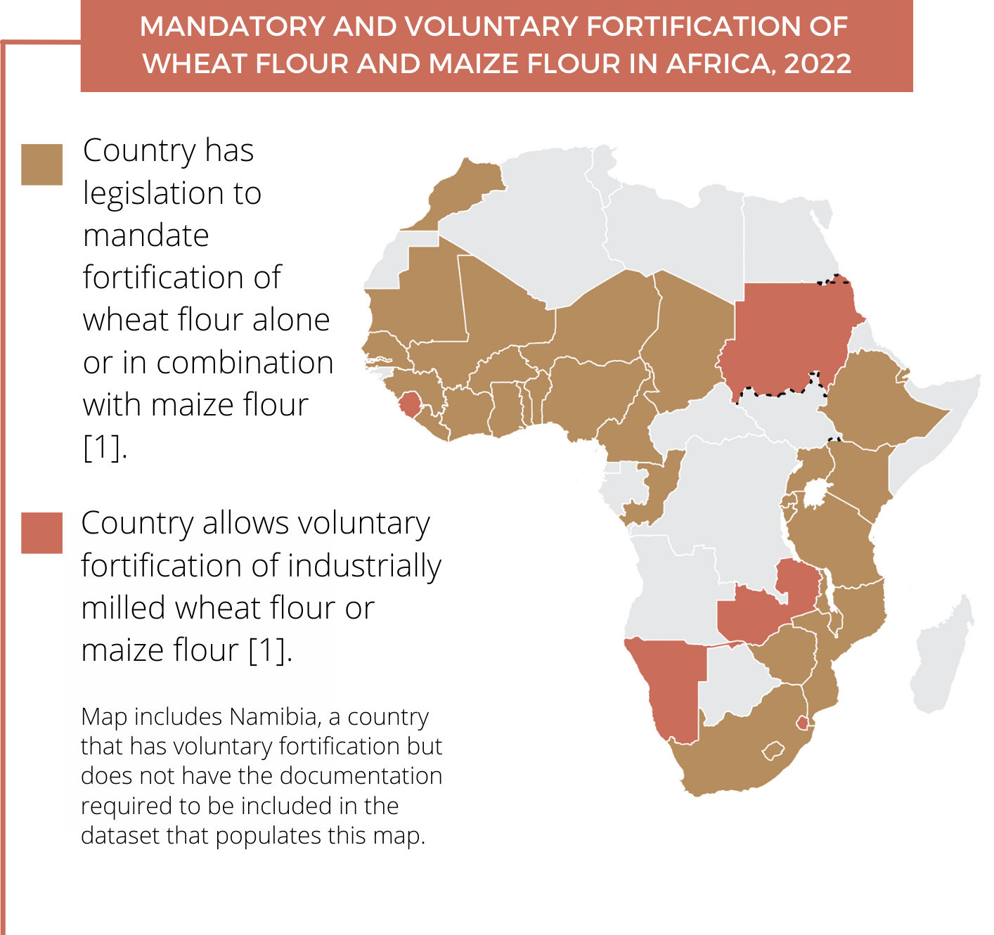
Key Achievements
Notes:
Tremendous progress has been made across Africa since Smarter Futures began. The achievements on this slide just scratch the surface.
By developing resources and helping countries build robust fortification programs and awareness on preventing health consequences like neural tube defects, the program has reached approximately 723 million people on the continent. We’ve provided specialized support to 26 countries and convened at least 27 trainings and stakeholder meetings.
In 2007, when the program was first created, only seven countries on the continent had legislation for mandatory or voluntary fortification of a grain [1]. As of July 2022, 30 countries have legislation to mandate the fortification of wheat flour alone or in combination with maize flour. Five countries allow the voluntary fortification of either flour. And—though no country in Africa mandates the fortification of rice yet—Smarter Futures has mapped opportunities for rice fortification [1]. Although this progress cannot be attributed to the impact of Smarter Futures alone, the program's meetings, workshops, trainings, and other events were attended by stakeholders from 41 countries in Africa. Thirty-six of these 41 countries are now planning, implementing, or monitoring a national fortification program.
Next slide please.
[1] Food Fortification Initiative. Global Progress. Accessed 18/07/2022. [https://www.ffinetwork.org/globalprogress]

Slide 5
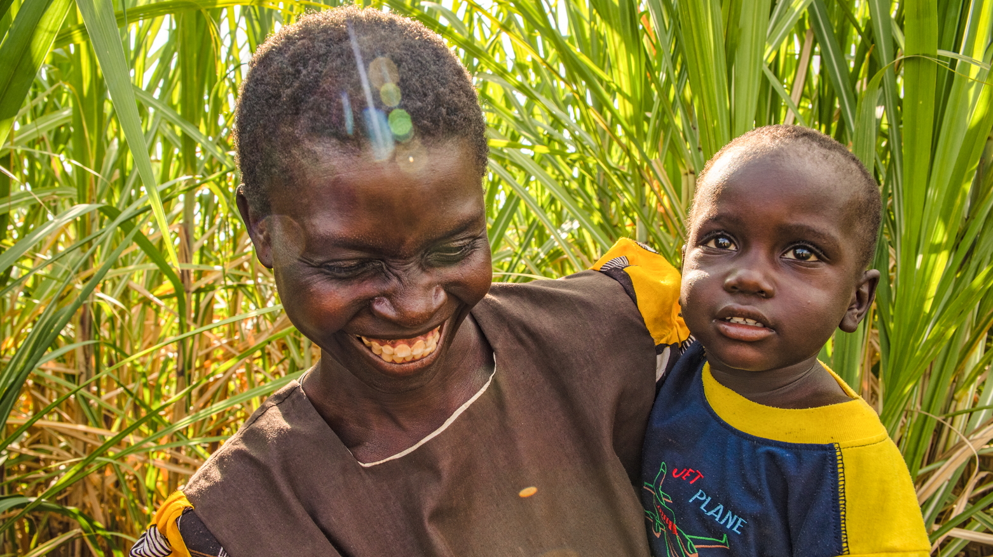
The Opportunity
We can avert at least
43,000 neural tube defects in Africa per year through country-led fortification programs.
Photo: RTI
Notes:
And yet, our work in Africa is not finished.
Specifically, there is an opportunity to avert at least 43,000 neural tube defects –and this is per year-- by making quality fortified wheat flour, maize flour, and/or rice available to the most vulnerable through country-led fortification programs.
In addition to reducing folic acid deficiencies, food fortification has the potential to provide other essential micronutrients that are often lacking in diets on the continent such as zinc; vitamins B1, B2, B3, and B12; vitamin A; and, in countries where there is low exposure to sunlight, vitamin D. These nutrients strengthen immune systems, reduce the risk of deadly childhood diseases, prevent the loss of sight, and promote health at every life stage.
Though the challenge is formidable, the solution is mighty. Food fortification is one of the most powerful tools we have to tackle malnutrition due to its distinct combination of qualities including scalability, sustainability, and cost-effectiveness. Smarter Futures and FFI are committed to ensuring all people can consume diets rich in folic acid and to preventing neural tube birth defects. Together, we can build a healthier future.
Thank you.

