Slide 1



Monitoring National Food Fortification Programs: A Web-Based Management Approach to Systematically Capture Program Compliance
Laura Rowe, Deputy Director, FFI
Florencia Vasta, Senior Associate, GAIN
FFI Town Hall Meeting
May 2021
Notes:
Good morning and good afternoon everyone. I’m pleased to be able to share with you some information and insights on our FortifyMIS system. Florencia Vasta from GAIN, whom I think most of you know, will be co-presenting with me today since ForitfyMIS is a joint project between FFI and GAIN.
This MIS was actually originally designed by PHC, further enhanced through a collaboration between PHC and GAIN and is now being rolled out by FFI and GAIN.
I will start by giving you a short high-level presentation on what the MIS and how it is intended to be used (some of you may be familiar with this presentation already). Then, Florencia and I will walk you through a mock inspection within the MIS. I would also like to acknowledge the support of Wilson, who has been instrumental in training countries on the use of the MIS. Wilson, please feel free to add…
The title of our presentation is…. So FortifyMIS designed specifically for monitoring national food fortification programs and capturing program compliance information. By compliance, we mean data on whether or not the correct amounts of vits and minerals have been added to the fortified foods per the national standard.

Slide 2
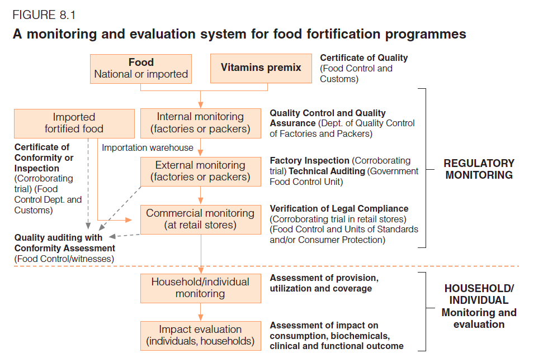
Regulatory Monitoring Framework
Source: Allen L, de Benoist B, Dary O, Hurrel R eds. Guidelines on Food Fortification with Micronutrients. Geneva. World Health Organization and Food & Agriculture Organization of the United Nations. 2006.
Notes:
Before we jump into what the MIS is and how it works, I’d like to step back and show you the kind of information it is designed to collect. The figure here shows you the monitoring and evaluation framework for food fortification that the WHO presents in their Guidelines on Food Fortification. The top portion outlines what is required to conduct regulatory monitoring and the bottom portion outlines what is required for HH/individual M&E. The MIS is only designed to collect information on the top portion of this diagram. This includes internal monitoring, import monitoring, external monitoring, and commercial monitoring.
This information is particularly important because if the quality of the food is not monitored and maintained, the nutritional impact of program could very well be jeopardized.

Slide 3
Data Collection Can Be Complex
Producing fortified products
A 2015 a review²: one of the top three requiring urgent attention:
Acting upon the results
Collecting data on quality
Simplify the process of compliance data collection for inspectors.
Reporting results
Analyzing data
Compiling results
¹Rowe 2015
²Luthringer CL, Rowe LA, Vossenaar et al. (2015) Regulatory monitoring of fortified foods: Identifying barriers and good practices. Global Health Science and Practice.3(3), 446-461.
Notes:
We also know that the collection of this kind of information can be complex. After the fortified product is produced, you need a means of collecting information on the quality of the product (usually done by government food control inspectors), analyzing that information, compiling the results, reporting the results, and finally, ensuring that action is taken based on the results so that improvements can occur. This can be a complicated process. And in many countries, multiple agencies and actors are involved in this cycle often with very little communication or coordination among themselves.
In 2015, a review was conducted of the top barriers to obtaining compliance information. One of the top three recommendations that came out of the review was the need to simply the process of compliance data collection for inspectors.

Slide 4

FortifyMIS: An Innovative Online Solution to Simplify Data Collection and Improve Program Outcomes
The objectives of the MIS are to:
        Provide a practical and standardized data aggregation solution for country-specific use;
        More efficiently and effectively track product compliance in real time;
        Enable countries to act upon identified gaps to improve program outcomes in a timely, cost-effective, and sustainable manner.

Slide 5
MIS Mapping: Lessons from 11 Countries
Senegal
Kenya
Tanzania
Malawi
Zimbabwe
South Africa
Jordan
Egypt
India
Bangladesh
Canada
Ngere S. (2016). Global Mapping of Management Information Systems for Fortification Monitoring. Unpublished Report, funded by GAIN with technical assistance from PHC.
Notes:
Before designing the MIS, a mapping exercise was completed of countries around the world that already used some sort of a MIS for fortification. It turns out there were 11 countries that used a MIS for fortification. Lessons learned from these systems were integrated into the design of FortifyMIS.

Slide 6
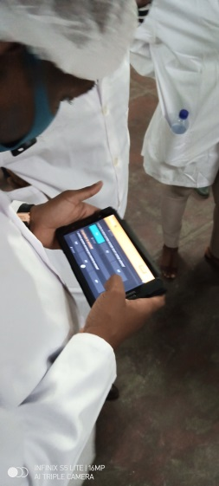
How Does It Work and Who Are the Users?
Point of use data collection
Users include:
  The government ministry responsible for overseeing the fortification program
  Food producers
  Government food control authorities / Regulatory inspectors
  Laboratories
Notes:
So, who uses the MIS?

Slide 7
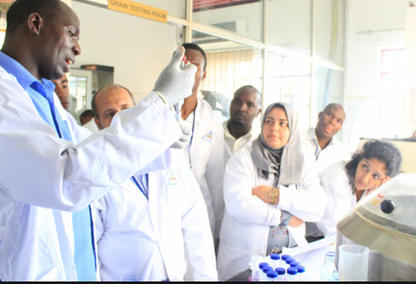
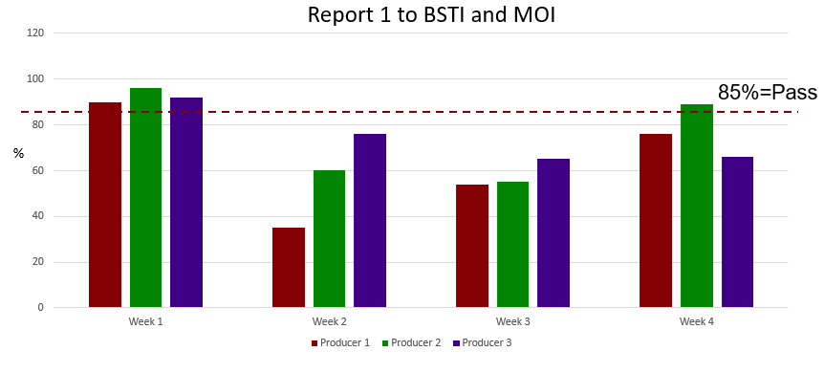
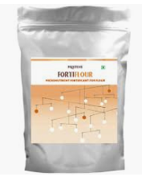
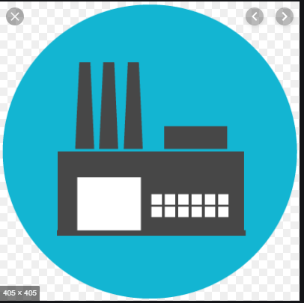
Results are analyzed and summarized visually on dashboards giving a producer-specific or national picture of compliance for quick action and improvements
Data is entered into FortifyMIS via a hand-held device by producers, inspectors, and lab staff
Audit and / or inspection results from production facilities, border points, or markets is collected by food control inspectors or food producers
Notes:
Taking a high level look at how the MIS is used, this slide presents three main steps. First,

Slide 8
FortifyMIS Basic Features
Using hand-held device, user has a unique login and password.
Users have individual roles, access rights, and viewing privileges.
Decentralized and real-time data input so no waiting for report.
Fully customized to mimic a country’s monitoring framework
  National Standards
  Audit and inspection checklists
  Geographic locations
  Producers/brands, importers, border points, markets
  Laboratories

Slide 9
FortifyMIS Basic Features
Automatically generates dashboards aggregated by producer, time, geographic location, etc.
Offline and online functionality.
Can accommodate multiple languages.
Housed on a cloud server where data is stored on a stable platform with multiple backups.
Able to integrate with other IT systems (e.g. HMIS).

Slide 10
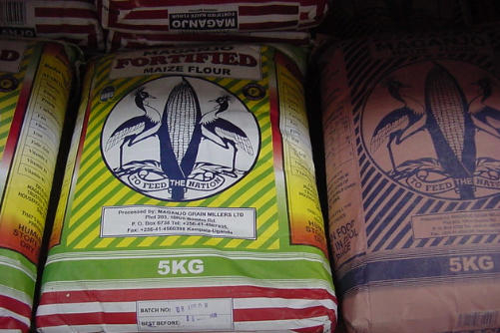

Food Producers and Food Control Inspectors
Notes:
Florencia will walk us through a mock external producer inspection.

Slide 11
Laboratories
Notes:
Once an inspection has been submitted, lab staff can then log in FortifiyMIS to see which samples are awaiting analysis.
Once these samples are analyzed, lab staff enter test results, which are linked to the relevant audit automatically.
I will demonstrate this by logging in as a lab user following the mock external producer inspection.

Slide 12
Program Managers
Notes:
Have the ability to view data visually on the dashboard using graphs and maps. This data can be aggregated and disaggregated by various components….

Slide 13
Reminders About FortifyMIS
FortifyMIS is not a replacement for a national monitoring system and requires a monitoring framework to exist and already be in use.
FortifyMIS should not create any new procedures. It uses existing procedures more effectively.
Country-specific data will not be shared. There is no requirement or automatic data linkage made between FortifyMIS and implementing partners or global reporting mechanisms. However, data sharing is encouraged.

Slide 14

Global Use of FortifyMIS
Countries where trainings are occurring:
    Bangladesh
    Mozambique
    Tanzania
Photo: Xaume Olleros/RTI

Slide 15

      Thank you!
Photo: Benedicte Kurzen

