Slide 1
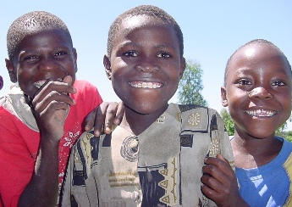

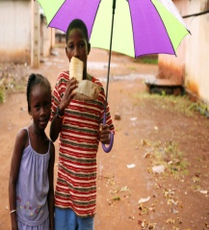
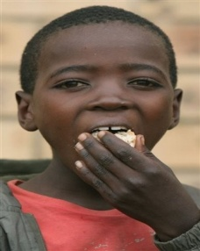
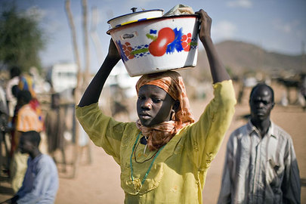



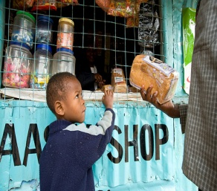

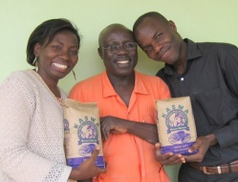
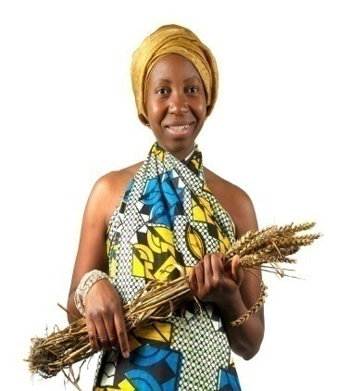
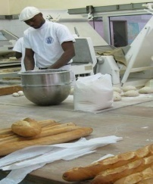

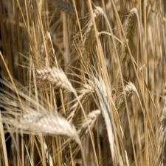
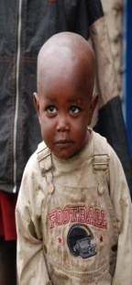
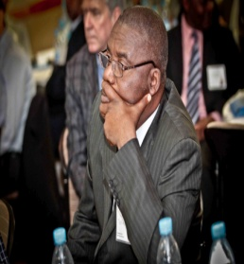

Africa Strategy and Cereal Grain Fortification Analysis
<
Updated May 2022

Slide 2
Appreciation
Data collection and analysis support from Emory graduate students: Ms. Nchedo Ezeokoli and Ms. Nikhila Gandrakota
Thanks to FFI Africa Team and the Smarter Futures Steering Committee Members for guidance on country status and input into this analysis

Slide 3
Presentation Outline
Process / Timeline
Methodology
Partner Mapping Snapshot
Data to Inform Country Rankings
  Country Profile Snapshot
  Grain Availability
  Fortification Status
  Updated FFI Color Codes
  Priority Matrix Results
Proposed Strategic Priorities
Annex: Africa Context

Slide 4
Process/Timeline
August 2018
Student hired to update strategy through partner interviews and database reviews
October 2018
Interview and database reviews began
November 2018 – February 2019
Country-specific profiles updated; priority matrixes created; preliminary analysis complete
May 2018
Need to update the 2011 Africa Strategy identified

Slide 5
Process/Timeline
April 2019
Presentation of draft to FFI Executive Management Team
May-Sept 2019
Finalize country profiles and update prioritizations for input into agency work plans
February 2019
Presented draft to Smarter Futures Steering Committee for review; Updated information from partners due March 31
Notes:
Extensive time spent in Hamburg at the Smarter Futures Steering Committee Meeting vetting the data on this first draft.

Slide 6
Presentation Outline
Process / Timeline
Methodology
Partner Mapping Snapshot
Data to Inform Country Rankings
  Country Profile Snapshot
  Grain Availability
  Fortification Status
  Updated FFI Color Codes
  Priority Matrix Results
Proposed Strategic Priorities
Annex: Africa Context

Slide 7
Methodology and Data Sources
Assessment of 54 African countries via:
  Partner interviews
    FFI
    International Federation for Spina Bifida and Hydrocephalus (IF)
    Global Alliance for Improved Nutrition (GAIN)
    Nutrition International
    Technoserve
    World Food Programme (WFP)
    Attempted to speak with Hellen Keller International
  FFI, Global Fortification Data Exchange (GFDx), World Bank, and Food and Agriculture Organization (FAO) database analyses
Notes:
Western Sahara and Somaliland not includes as their independence is disputed.

Slide 8
Allowed us to update information on:
Partner mapping
Country Profiles:
    Disease burden
    Grain availability / consumption
    Milling structure
    Production data
    Monitoring structures and protocols
    Coverage
    Fortification implementation status
    Quality data
    Political stability and corruption index
    Current program challenges

Slide 9
Six priority country tiers were identified by combining information from:
  Partner interviews
  Updated country profiles
  Updated FFI country-specific color codes
  Results of a priority matrix exercise

Slide 10
Data Limitations
Limited / no information on monitoring structures and protocols and quality or compliance data
Does not take into account whether standards meet WHO recommendations or not (new data exists)
Does not take into account % urban/rural reach
Does not review other potential vehicles outside of the three grains
Data collection did not rely on in-country visits
Notes:
Urban/rural disparities are not shown.

Slide 11
Presentation Outline
Process / Timeline
Methodology
Partner Mapping Snapshot
Data to Inform Country Rankings
  Country Profile Snapshot
  Grain Availability
  Fortification Status
  Updated FFI Color Codes
  Priority Matrix Results
Proposed Strategic Priorities
Annex: Africa Context

Slide 12
Partner Mapping Snapshot
Country | Active Partners
Algeria | FFI, WFP, IF member, WHO
Angola | FFI, HKI, WHO
Benin | WFP, FAO
Botswana | FFI, SADC, UNICEF, Technoserve
Burkina Faso | WFP, GAIN, NI, HKI
Burundi | WFP, Dutch Embassy
Cabo Verde
Cameroon | HKI, IF parent association
Central African Republic
Chad | WFP
Comoros | SADC
Congo | UNICEF, WFP (cassava)
Cote d'Ivoire | FAO, WFP, NI, HKI
Democratic Republic of the Congo
Djibouti | WFP
Egypt | FFI, WFP, FAO, WHO
Country | Active Partners
Equatorial Guinea
Eritrea
Ethiopia | FFI, GAIN, NI, UNICEF, Technoserve, IF member
Kenya | Technoserve, GAIN, NI, UNICEF, HKI, 2FAS, Lumber Mill Association, Deutsche Gesellschaft für, IF member, EU funding to Kenyatta University
Gabon
Gambia | NI, GAIN, 2FAS, FAO
Ghana | HKI, WFP
Guinea | HKI
Guinea-Bissau
Nigeria | NI, Technoserve, GAIN,NI, HKI, IF member
Lesotho | GAIN, SADC, ECSA
Liberia | WFP, UNICEF, FFI
Libya | WHO
Notes:
Premix suppliers and individual private sector companies widespread across Africa not included here. Currently being refined to include specifically what these groups are doing in the country re: fortification. This will be captured in the country profiles.

Slide 13
Partner Mapping Snapshot
Country | Active Partners
Tanzania | NI, GAIN, HKI, Technoserve, Bakhresa Milling Company, IF member, PHC/Sanku
Seychelles | SADC
Sierra Leone | USAID, HKI
Somalia
South Africa | FFI, IF member
South Sudan
Sudan | WHO, WFP, IF member
Eswatini | WFP, SADC
Togo | HKI
Tunisia | WHO
Uganda | USAID, GAIN, SHA-U, IF member, other Pull partners
Zambia | SNV (Netherlands Dev Org), IF member
Zimbabwe | FFI, WFP, UNICEF
Country | Active Partners
Madagascar | WFP, SADC
Malawi | GAIN, IF member, FFI, CAMA, other Pull partners, UNICEF, Irish Aid
Mali | NI, UNICEF, HKI, GAIN
Mauritania
Mauritius | FFI, SADC, ECSA, GAIN
Morocco | FFI, WFP, IF member, WHO
Mozambique | NI, GAIN, HKI
Namibia | FFI, Namib Mills
Niger | NI, HKI
Rwanda | GAIN
Sao Tome and Principe
Senegal | NI, GAIN, HKI, UNICEF, WFP

Slide 14
Presentation Outline
Process / Timeline
Methodology
Partner Mapping Snapshot
Data to Inform Country Rankings
  Country Profile Snapshot
  Grain Availability
  Fortification Status
  Updated FFI Color Codes
  Priority Matrix Results
Proposed Strategic Priorities
Annex: Africa Context

Slide 15
1. Detailed Country Profile
EXAMPLE: South Africa
Legislation, Milling Industry, and Fortification
 | Legislation | Number of industrial mills (<20 metric tons/day) | % flour produced in industrial mills | % industrially milled flour that is fortified | % flour that meets national standard
Wheat | Y | 26 | 98 | 60 | TBD
Maize | Y | 40 | 75 | 0 | TBD
Rice | N/A | 0 | 0 | 0 | TBD
Grain Production, Imports, Exports (metric tons), Food Supply (metric tons), and Availability (grams/capita/day)
 | Domestic Production | Grain Imports | Grain Exports | Flour Imports | Flour Exports | Grain Available
Wheat | 1,870,000 | 1,401,984 | 220,015 | 30,741 | 151,606 | 165
Maize | 11,810,600 | 40,311 | 2,604,890 | 8,102 | 333,939 | 274
Rice | 3,000 | 1,266,063 | 114,923 | 0 | 0 | 48
Source: Food and Agriculture Organization (FAO) of the United Nations using 2013 data, the last year with all data available in March 2018
Notes:
This is what drives the priority matrix.

Slide 16
Detailed Country Profile
EXAMPLE: South Africa
Nutrients Added Through Fortification (ppm)
Neural Tube Defects, Anemia, Iron Deficiency Anemia, Zinc Intake

Slide 17
Detailed Country Profile
EXAMPLE: South Africa
COUNTRY STATISTICS
ACTIVE PARTNERS
Lead Partners | Contacts
SADC | Pontsho Sepoloane: psepoloane@sadc.int
FFI | Laura Rowe: laura.rowe@ffinetwork.org

Slide 18
Detailed Country Profile
EXAMPLE: South Africa| Narrative
MONITORING STRUCTURES & PROTOCOLS
Finalization of QA/QC guidelines and tools (e.g. audit checklist).
Sensitization and capacity-building of the government’s Environmental Health personnel on amended regulations and compliance monitoring and enforcement system.
KEY BARRIERS & CHALLENGES
Current fortification levels in maize and wheat flour do not provide adequate levels for young children’s consumption.
Not all wheat flour is fortified.
Fortification levels are not harmonized with WHO recommendations. The amended regulations need to be finalized.
HACCP is not mandatory.
Compliance monitoring system is not adequate.
TECHNICAL ASSISTANCE NEEDED
NEXT STEPS
Publication of new regulations for maize and wheat flour fortification.
Engagement with industry to request implementation of HACCP and linking HACCP with fortification QA/QC principles.
Finalization of QA/QC guidelines and tools.

Slide 19
Detailed Country Profile
EXAMPLE: South Africa| Narrative
MONITORING STRUCTURES & PROTOCOLS
Finalization of QA/QC guidelines and tools (e.g. audit checklist).
Sensitization and capacity-building of the government’s Environmental Health personnel on amended regulations and compliance monitoring and enforcement system.
KEY BARRIERS & CHALLENGES
Current fortification levels in maize and wheat flour do not provide adequate levels for young children’s consumption.
Not all wheat flour is fortified.
Fortification levels are not harmonized with WHO recommendations. The amended regulations need to be finalized.
HACCP is not mandatory.
Compliance monitoring system is not adequate.
TECHNICAL ASSISTANCE NEEDED
    These profiles are what drives the matrix and strategic priorities. Results are only as good as what is in the country profiles!
NEXT STEPS
Publication of new regulations for maize and wheat flour fortification.
Engagement with industry to request implementation of HACCP and linking HACCP with fortification QA/QC principles.
Finalization of QA/QC guidelines and tools.

Slide 20
Presentation Outline
Process / Timeline
Methodology
Partner Mapping Snapshot
Data to Inform Country Rankings
  Country Profile Snapshot
  Grain Availability
  Fortification Status
  Updated FFI Color Codes
  Priority Matrix Results
Proposed Strategic Priorities
Annex: Africa Context

Slide 21
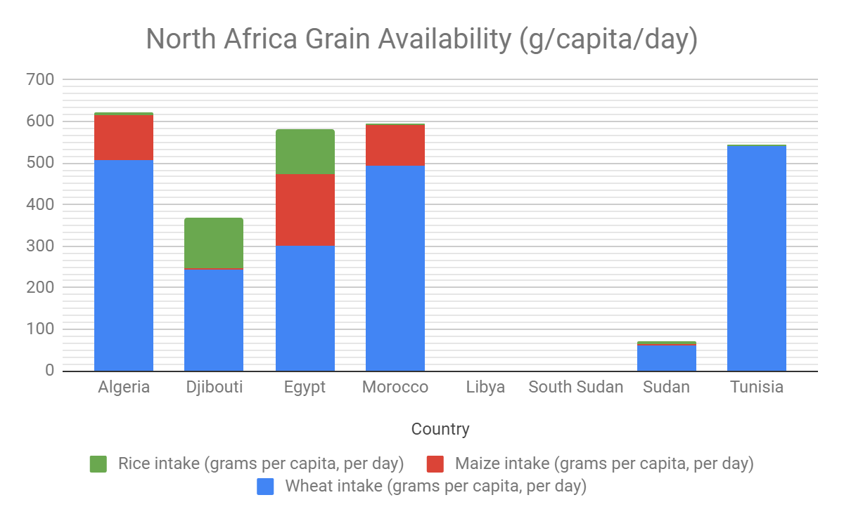
Source: FFI Database
Notes:
Note: Does not show internal differences within a country. For example, if there is a difference between rural vs. urban or in other staples consumed (ex. Ethiopia – wheat (urban), teff (rural)). There are urban/rural disparities that are not shown here.

Slide 22
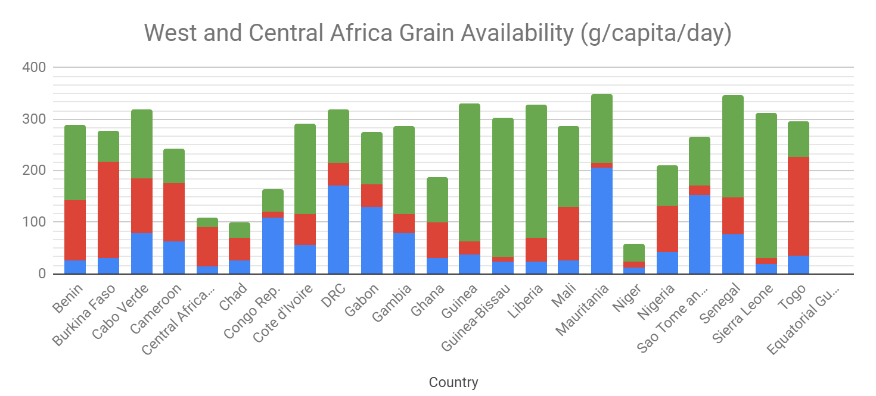
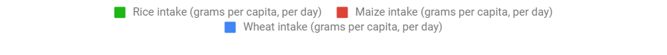
Source: FFI Database

Slide 23
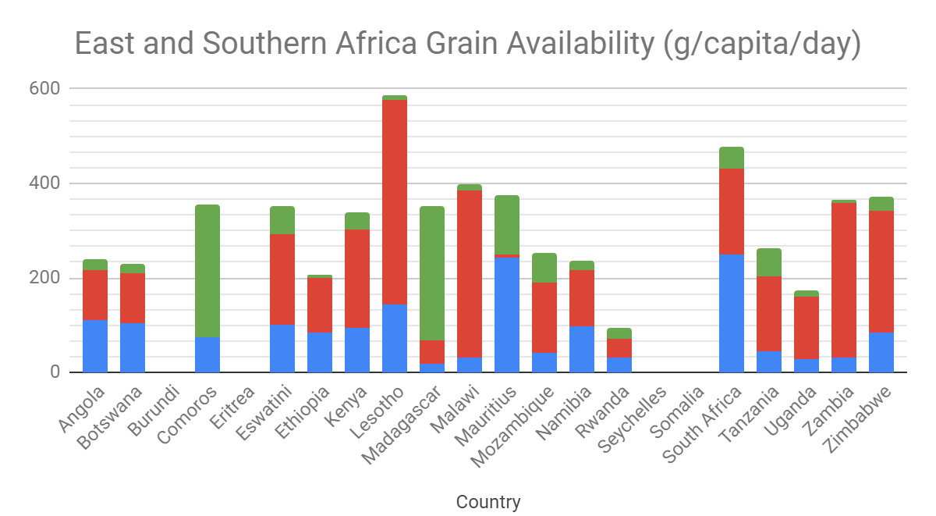
Source: FFI Database

Slide 24
Presentation Outline
Process / Timeline
Methodology
Partner Mapping Snapshot
Data to Inform Country Rankings
  Country Profile Snapshot
  Grain Availability
  Fortification Status
  Updated FFI Color Codes
  Priority Matrix Results
Proposed Strategic Priorities
Annex: Africa Context

Slide 25
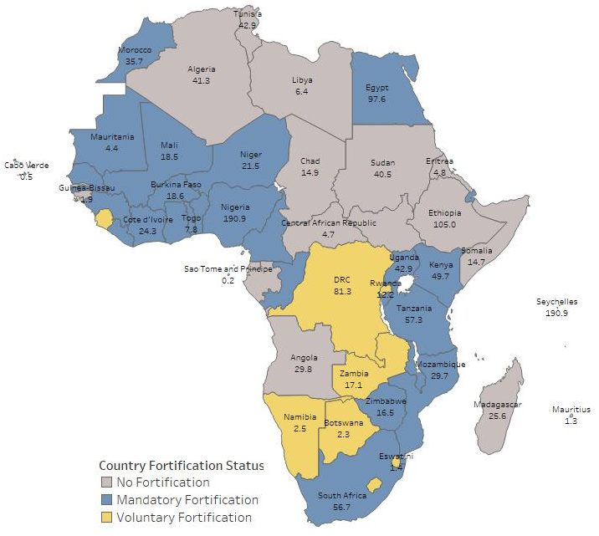
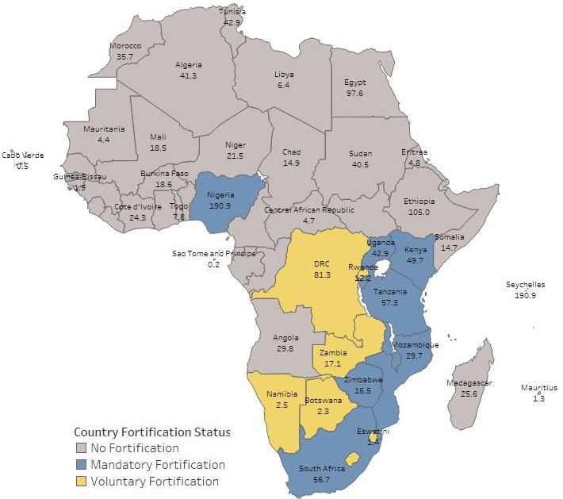
3. Fortification Status
Wheat Flour
Maize Flour
Source: FFI Database
Notes:
Voluntary means standards but no legislation.

Slide 26
Presentation Outline
Process / Timeline
Methodology
Partner Mapping Snapshot
Data to Inform Country Rankings
  Country Profile Snapshot
  Grain Availability
  Fortification Status
  Updated FFI Color Codes
Priority Matrix Results
Proposed Strategic Priorities
Annex: Africa Context

Slide 27
4. Updated FFI Color Codes
Wheat Flour
Maize Flour
 | Over 75% of industrial-milled grain fortified in country. FFI's main role is monitoring.
 | Confident country will move to 75% in the next one year. Targeted support as needed.
 | Organized efforts to increase fortification within country. Without support to fill gaps, moving to 75% unlikely.
 | No fortification activity in the country. Major support necessary to reach 75% fortification
 | Fortification of grain likely to have very limited health impact; or no data on country
Notes:
Wheat Flour
Purple: Benin, Cameroon, Cape Verde, Congo, CIV, Dijibouti, Eswatini, Gambia, Ghana, Guinea, Kenya, Lesotho, Liberia, Mali, Namibia, Niger, Nigeria, Sierra Leone, Senegal, Tanzania, Togo, Uganda
Green: Algeria, Burkina Faso, Mozambique, South Africa, Sudan
Yellow: Angola, Botswana, Gabon, Egypt, Malawi, Mauritania, Morocco, Sao Tome and Principe, Tunisia, Zambia, Zimbabwe, Democratic Republic of the Congo, Ethiopia, Eritrea, Madagascar, Mauritius, Rwanda, Burundi, Seychelles
Red: Comoros, Equatorial Guinea, Libya
Grey: Central African Republic, Chad, Somalia, Guinea-Bissau, South Sudan
Maize Flour
Purple: Cote d’Ivoire, Lesotho, Nigeria
Green: Kenya, Mozambique, Namibia, South Africa
Yellow: Benin, Burkina Faso, Tanzania, Zambia, Zimbabwe, Uganda, Rwanda
Red: Botswana, Burundi, Cameroon, Cabo Verde, Eswatini, Gabon, Togo

Slide 28
Strategic Priorities: Wheat Flour
# of Countries | Population in Millions | % of Total African Population
22 | 527 | 40.0
7 | 227 | 17.7
9 | 227 | 17.7
6 | 230 | 17.9
4 | 12.7 | 1.0
6 | 55.1 | 4.3
Notes:
Cape Verde (not pictured) is blue.
South Sudan (not pictured) is blue.
Sao Tome (not pictured) is purple.
Madagascar (not pictured) is pink.
Mauritius (not pictured) is pink.
Comoros (not pictured) is orange.
Seychelles (not pictured) is orange.

Slide 29
Strategic Priorities: Maize Flour
# of Countries | Population in Millions | % of Total African Population
4 | 260 | 20.2
2 | 12 | 0.9
5 | 34 | 2.6
8 | 168 | 13.1
2 | 2 | 0.2
34 | 809 | 63.0
Notes:
Cape Verde (not pictured) is pink.

Slide 30
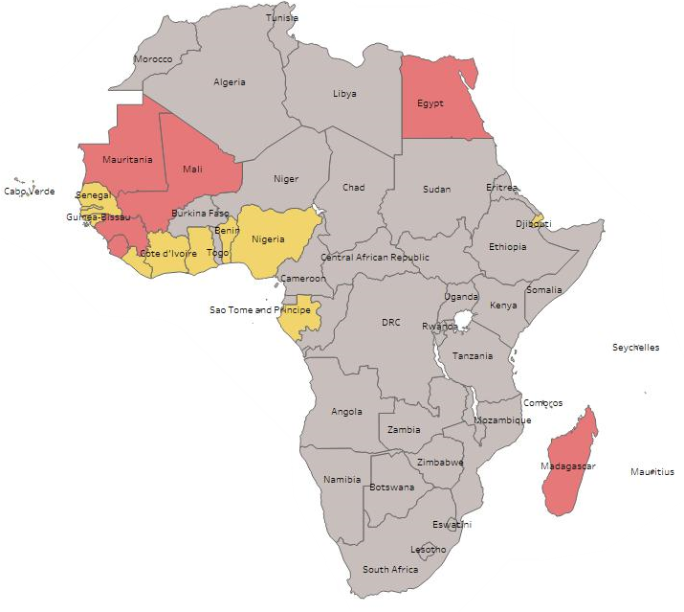
Updated FFI Color Codes: Rice
 | Over 75% of industrial-milled rice fortified in country. FFI's main role is monitoring.
 | Confident country will move to 75% in the next one year. Targeted support as needed.
 | Organized efforts to increase fortification within country. Without support to fill gaps, moving to 75% unlikely.
 | No fortification activity in the country. Major support necessary to reach 75% fortification
 | Fortification of grain likely to have very limited health impact; or no data on country
Notes:
Madagascar should be yellow

Slide 31
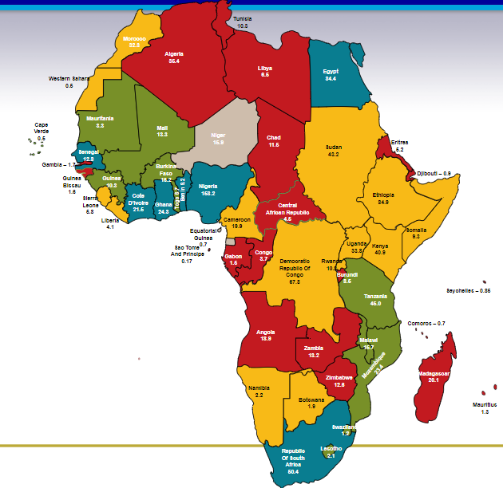
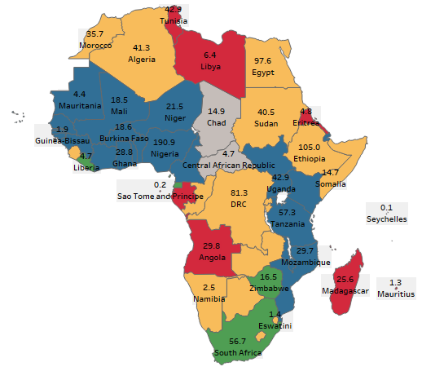
Wheat Flour Comparison: 2011 vs. 2018

Slide 32
Presentation Outline
Process / Timeline
Methodology
Partner Mapping Snapshot
Data to Inform Country Rankings
  Country Profile Snapshot
  Grain Availability
  Fortification Status
  Updated FFI Color Codes
  Priority Matrix Results
Proposed Strategic Priorities
Annex: Africa Context

Slide 33
5. Priority Matrix Development
Countries were ranked according to two groups of indicators to create an overall score:
  Health impact
  Ease of implementation
Countries with an updated FFI color code of purple or gray were not considered in the Priority Matrix.
 | Over 75% of industrial-milled rice fortified in country. FFI's main role is monitoring.
 | Confident country will move to 75% in the next one year. Targeted support as needed.
 | Organized efforts to increase fortification within country. Without support to fill gaps, moving to 75% unlikely.
 | No fortification activity in the country. Major support necessary to reach 75% fortification
 | Fortification of grain likely to have very limited health impact; or no data on country

Slide 34
Country Priority Ranking
Health Impact
Ease of Implementation
Population (15%)
NTDs per year (7.5%)
NTDs per 10,000 births (7.5%)
Anemia in non-pregnant woman (30%)
Urban population (5%)
% Cereal milled industrially (20%)
Cereal availability (15%)
Final score of 1-5
1 = minimal impact
5 = maximum impact
% Living in urban settings (20%)
Political stability* (10%)
Government effectiveness* (10%)
Regulatory quality* (10%)
Number of industrial-sized mills (20%)
% Cereal milled industrially (10%)
Mandatory salt iodization (20%)
Final score of 1-5
1 = minimal impact
5 = maximum impact
* World Bank Indicators
Health impact and ease of implementation
combined to form total score.
Notes:
These indicators were taken from previous regional strategies conducted by FFI (Europe and India strategies). All variables were ranked from 1-5 and then two weighted aggregate scores were created.
Proportion of cereal milled by industrial mills was designated as a Health Impact variable because if only a small proportion of the total cereal available to the population is milled by industrial mills, the impact of fortification will be small and vice versa. This variable includes imported flour which is assumed to originate from industrial mills.

Slide 35
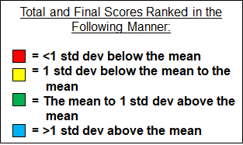
Final Wheat Matrix
 | Health Impact Total Score | Implementation Total Score | Final Score (Health+Implementation)
Burundi | 2.05 | 2.00 | 4.05
Seychelles | 1.08 | 3.00 | 4.08
Comoros | 2.33 | 2.00 | 4.33
Ethiopia | 2.73 | 2.30 | 5.03
Rwanda | 2.15 | 3.10 | 5.25
Lesotho | 2.65 | 2.50 | 5.15
Mauritius | 2.93 | 3.20 | 6.13
Eritrea | 2.83 | 2.30 | 5.13
Eswatini | 2.78 | 2.60 | 5.38
Libya | 3.40 | 2.60 | 6.00
Equatorial Guinea | 3.13 | 2.70 | 5.83
Madagascar | 3.45 | 2.70 | 6.15
DRC | 3.13 | 2.50 | 5.63
Somalia | 3.75 | 2.20 | 5.95
Zimbabwe | 3.10 | 2.60 | 5.70
Sudan | 3.83 | 2.70 | 6.53
Liberia | 3.48 | 2.80 | 6.28
Congo Rep. | 3.93 | 2.60 | 6.53
Sao Tome and Principe | 3.45 | 3.00 | 6.45
Zambia | 3.00 | 3.40 | 6.40
Namibia | 3.05 | 3.20 | 6.25
Sierra Leone | 3.63 | 3.00 | 6.63
Angola | 3.98 | 2.50 | 6.48
Botswana | 2.75 | 3.70 | 6.45
Gabon | 3.90 | 3.10 | 7.00
Tunisia | 3.90 | 2.90 | 6.80
Egypt | 4.63 | 3.10 | 7.73
Algeria | 4.33 | 3.50 | 7.83
Morocco | 4.18 | 3.60 | 7.78
South Africa | 3.88 | 3.50 | 7.38
Notes:
*Burkina Faso and Mozambique are missing

Slide 36
Final Wheat Fortification Matrix
Country Ranking
 |  | Egypt | Algeria Morocco
Somalia | Sudan Liberia Congo Rep. Libya Madagascar Angola | Sao Tome & Principe Sierra Leone Gabon Tunisia | South Africa
Ethiopia Eritrea | Lesotho Eswatini Equatorial Guinea DRC Zimbabwe | Mauritius Namibia | Zambia Botswana
Burundi Comoros |  | Seychelles Rwanda
Great
Health Impact
Low
Great
Ease of Implementation
Notes:
This is another view of the results for the variable grouping, looking at the results dichotomously.
Data driven. Attempt at objective decision making.
It’s worth nothing that our political stability indicator comes from the WB’s 2017 data. Today, Algeria would not appear with such a high implementation score.

Slide 37
Final Maize Matrix
 | Health Impact Total Score | Implementation Total Score | Final Score (Health+Implementation)
Burundi | 1.58 | 1.00 | 2.58
Malawi | 2.10 | 1.40 | 3.50
Rwanda | 1.63 | 3.00 | 4.63
Eswatini | 2.50 | 2.20 | 4.70
Lesotho | 2.63 | 2.20 | 4.83
Botswana | 1.88 | 3.00 | 4.88
Togo | 3.20 | 1.50 | 4.70
Uganda | 2.58 | 2.70 | 5.28
Cameroon | 2.90 | 2.10 | 5.00
Cabo Verde | 2.35 | 2.80 | 5.15
Benin | 3.03 | 2.30 | 5.33
Burkina Faso | 3.58 | 1.60 | 5.18
Tanzania | 3.70 | 2.20 | 5.90
Zimbabwe | 3.25 | 2.50 | 5.75
Zambia | 3.90 | 2.80 | 6.70
Namibia | 3.05 | 4.00 | 7.05
South Africa | 4.25 | 3.90 | 8.15
Notes:
*Gabon and Mozambique are missing

Slide 38
Final Maize Fortification Matrix
Country Ranking
Great
 | Tanzania | Zambia | South Africa
Togo Burkina Faso | Cameroon Benin | Zimbabwe | Namibia
Malawi | Eswatini Lesotho | Uganda Cabo Verde
Burundi |  | Rwanda Botswana Togo
Health Impact
Low
Great
Ease of Implementation

Slide 39
Final Rice Matrix
 | Health Impact Total Score | Implementation Total Score | Final Score (Health+Implementation)
Comoros | 1.80 | 1.30 | 3.10
Mauritius | 1.28 | 2.40 | 3.68
Sao Tome and Principe | 1.38 | 2.50 | 3.88
Guinea-Bissau | 2.75 | 1.30 | 4.05
Mauritania | 2.28 | 2.10 | 4.38
Madagascar | 2.85 | 1.50 | 4.35
Gabon | 2.48 | 2.40 | 4.88
Egypt | 3.13 | 2.00 | 5.13
Guinea | 3.28 | 1.30 | 4.58
Nigeria | 2.78 | 1.80 | 4.58
Sierra Leone | 3.03 | 1.90 | 4.93
Cabo Verde | 2.43 | 3.00 | 5.43
Gambia | 2.35 | 2.60 | 4.95
Mali | 3.50 | 1.70 | 5.20
Djibouti | 2.70 | 2.40 | 5.10
Liberia | 3.35 | 2.00 | 5.35
Benin | 2.98 | 2.40 | 5.38
Cote d'Ivoire | 3.68 | 2.10 | 5.78
Senegal | 3.70 | 2.60 | 6.30
Ghana | 3.53 | 2.90 | 6.43

Slide 40
Final Rice Fortification Matrix
Country Ranking
Great
 | Cote d’Ivoire Mali | Senegal | Ghana
Madagascar Guinea | Egypt Nigeria Sierra Leone Liberia | Benin
Guinea-Bissau | Mauritania | Gabon Gambia Djibouti | Cabo Verde
Comoros |  | Mauritius Sao Tome & Principe
Health Impact
Low
Great
Ease of Implementation

Slide 41
Presentation Outline
Process / Timeline
Methodology
Partner Mapping Snapshot
Data to Inform Country Rankings
  Country Profile Snapshot
  Grain Availability
  Fortification Status
  Updated FFI Color Codes
  Priority Matrix Results
Proposed Strategic Priorities
Annex: Africa Context

Slide 42
Strategic Priority Categories
Monitoring & Support for Adequacy Over 75% of industrially-milled grain available in the country is fortified. Main role is to ensure monitoring structures are in place and effective.
Priority 1 Confident country will move to 75% in 2020-2022. High health impact and ease of implementation score.
Priority 2 Industrial milling processes and political environment make fortification viable (moderate ease of implementation score). Burden of disease can be addressed by fortification (moderate health impact score). Current status indicates additional focused efforts and support are needed to move to 75%.
Priority 3 Fortification has not been a priority but there is interest in making it one. Potential for health impact.
Priority 4 The political environment may not favor fortification (low ease of implementation score) and / or consumption of cereal grain needs further understanding.
Gray Fortification of grain likely to have very limited health impact (low health impact score); or no data on country.
Notes:
Combines the updated FFI color codes with the results from the priority matrix.

Slide 43
Wheat Flour Summary
Monitor & Support | Priority 1 | Priority 2 | Priority 3 | Priority 4 | Gray
Benin, Cameroon, Cape Verde, Congo, Cote d’Ivoire, Djibouti, Eswatini, Gambia, Ghana, Guinea, Kenya, Lesotho, Liberia, Mali, Niger, Nigeria, Senegal, Tanzania, Togo, Uganda | Egypt, Gabon, Morocco, Mozambique, Sao Tome & Principe, Sierra Leone, South Africa, Tunisia | Algeria, Angola, Botswana, Burkina Faso, Congo Rep, Madagascar, Mauritius, Namibia, Rwanda, Sudan, Zimbabwe | DRC, Equatorial Guinea, Eswatini, Ethiopia, Lesotho, Seychelles | Burundi, Comoros | Central African Republic, Chad, Libya, Somalia, Guinea-Bissau, South Sudan
Notes:
Benin, Cabo Verde, Comoros, Cote d’Ivoire Djibouti, Gabon, Gambia, Ghana, Guinea-Bissau, Liberia, Nigeria, Senegal

Slide 44
Strategic Priorities: Wheat Flour
# of Countries | Population in Millions | % of Total African Population
22 | 527 | 40.0
7 | 243 | 18.9
12 | 201 | 15.6
6 | 191 | 14.9
2 | 11.3 | 0.9
6 | 55.1 | 4.3
Notes:
Cape Verde (not pictured) is blue.
South Sudan (not pictured) is blue.
Sao Tome (not pictured) is purple.
Madagascar (not pictured) is pink.
Mauritius (not pictured) is pink.
Comoros (not pictured) is orange.
Seychelles (not pictured) is orange.

Slide 45
Maize Flour Summary
Monitor & Support | Priority 1 | Priority 2 | Priority 3 | Priority 4 | Gray
Cote d’Ivoire, Lesotho, Nigeria, South Africa | Kenya | Namibia, Tanzania, Uganda, Zimbabwe | Benin, Burkina Faso, Botswana, Cameroon, Cape Verde, Eswatini, Gabon, Mozambique, Rwanda, Togo | Burundi | Algeria, Angola, Central African Republic, Chad, Comoros, Congo, Djibouti, DRC, Egypt Equatorial Guinea, Eritrea, Ethiopia, Gambia, Ghana, Guinea, Guinea-Bissau, Liberia, Libya, Madagascar, Mali, Malawi, Mauritania, Mauritius, Morocco, Niger, Sao Tome & Principe, Senegal, Seychelles, Sierra Leone, Somalia, South Sudan, Sudan, Tunisia

Slide 46
Strategic Priorities: Maize Flour
# of Countries | Population in Millions | % of Total African Population
4 | 260 | 20.2
1 | 50 | 0.04
4 | 119.2 | 0.09
10 | 109.7 | 0.08
1 | 10.5 | 0.01
34 | 809 | 63.0
Notes:
Cape Verde (not pictured) is pink.

Slide 47
Rice Summary
Monitor & Support | Priority 1 | Priority 2 | Priority 3 | Priority 4 | Gray
N/A | Benin, Cabo Verde, Comoros, Cote d’Ivoire Djibouti, Gabon, Gambia, Ghana, Guinea-Bissau, Liberia, Nigeria, Senegal |  | Egypt, Mauritania, Mauritius, Madagascar | Guinea, Mali, Sierra Leone | Algeria, Angola, Botswana, Burkina Faso, Burundi, Central African Republic, Chad, Congo Rep., DRC, Equatorial Guinea, Eritrea, Eswatini, Ethiopia, Kenya, Lesotho, Libya, Malawi, Morocco, Mozambique, Namibia, Niger, Rwanda, Seychelles, Somalia, South Africa, South Sudan, Sudan, Tanzania, Togo, Tunisia, Uganda, Zambia, Zimbabwe

Slide 48
Strategic Priorities: Rice
# of Countries | Population in Millions | % of Total African Population
0 | 0 | 0
12 | 284 | 22
0 | 0 | 0
4 | 128.8 | 10
3 | 38.8 | 3
33 | 809 | 63
Notes:
Cape Verde (not pictured) is purple.
Madagascar (not pictured) is purple.
Comoros, Mauritius, and Sao Tome (not pictured) are orange.

Slide 49
Proposed Approach:
Monitor & Support
Ensure compliance and quality data for fortification can be effectively collected by government and industry
Ensure standards are in line with WHO recommendations
Understand the breakdown of urban vs. rural reach (blue countries in West Africa)
Understand inherence challenges around compliance in specific countries and offer creative, practical, and sustainable solutions
Provide monitoring and surveillance support as needed
Regional workshop opportunity to address monitoring challenges

Slide 50
Proposed Approach:
Priority 1
Support to develop national legislation or revise existing standards to be in line with WHO Recommendations
Focus on monitoring progress of these countries and support in-country efforts as needed/requested and justified

Slide 51
Proposed Approach:
Priority 2 and Priority 3
Focus on understanding key challenge areas around design and implementation
  Staple food coverage and consumption, appropriate target vehicles, standards development, drafting and adoption of legislation, industry engagement and trainings, monitoring frameworks
Strengthen relationships with government, key in-country partners, and regional bodies
Coordinate technical support; evaluate progress and effectiveness

Slide 52
Proposed Approach:
Priority 4
Monitor country-specific situation
  Changing political environment
  Change in consumption patterns
Support meetings where a clear objective is identified to build in-country support for fortification
Support broad advocacy efforts with identified leaders/partners/champions in-country and across the region

Slide 53
FFI
Africa Strategy
Thank you!

Slide 54
ANNEX
African Context

Slide 55
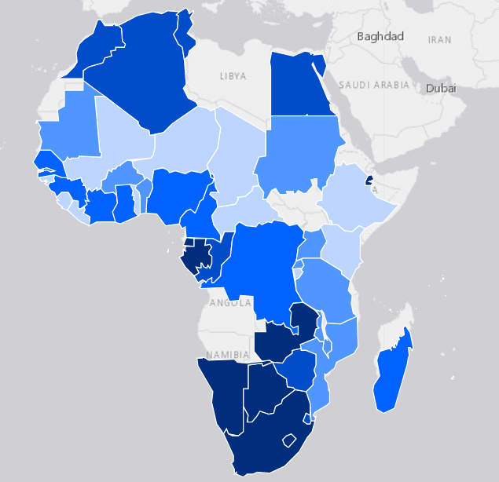
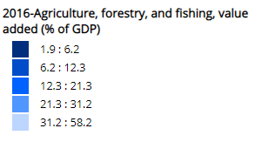
AFRICA Context:
Agriculture Value (% of GDP)
  World Bank Indicator, 2016
Notes:
Source: World Development Indicators.

Slide 56
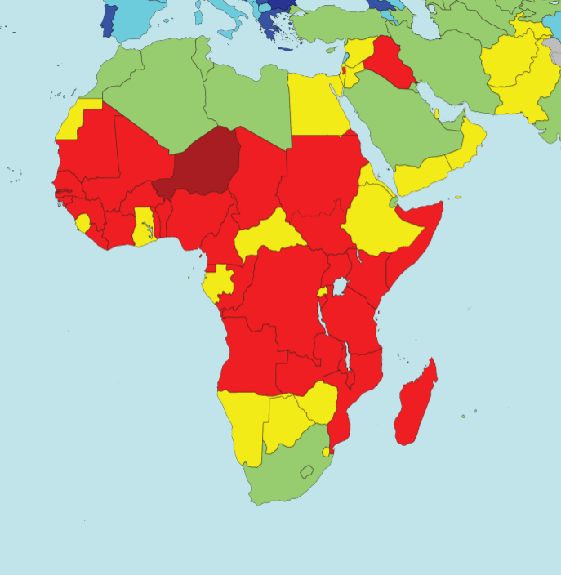
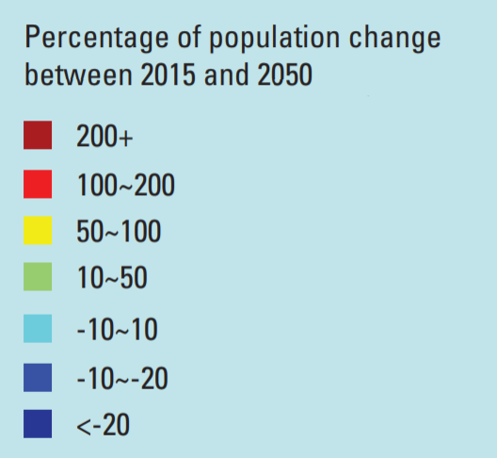
AFRICA Context:
Population Density

Slide 57
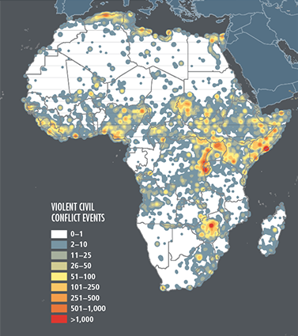
AFRICA Context:
Frequency of violent civil conflict
  IFPRI Global Food Policy Report 2014-2015

Slide 58
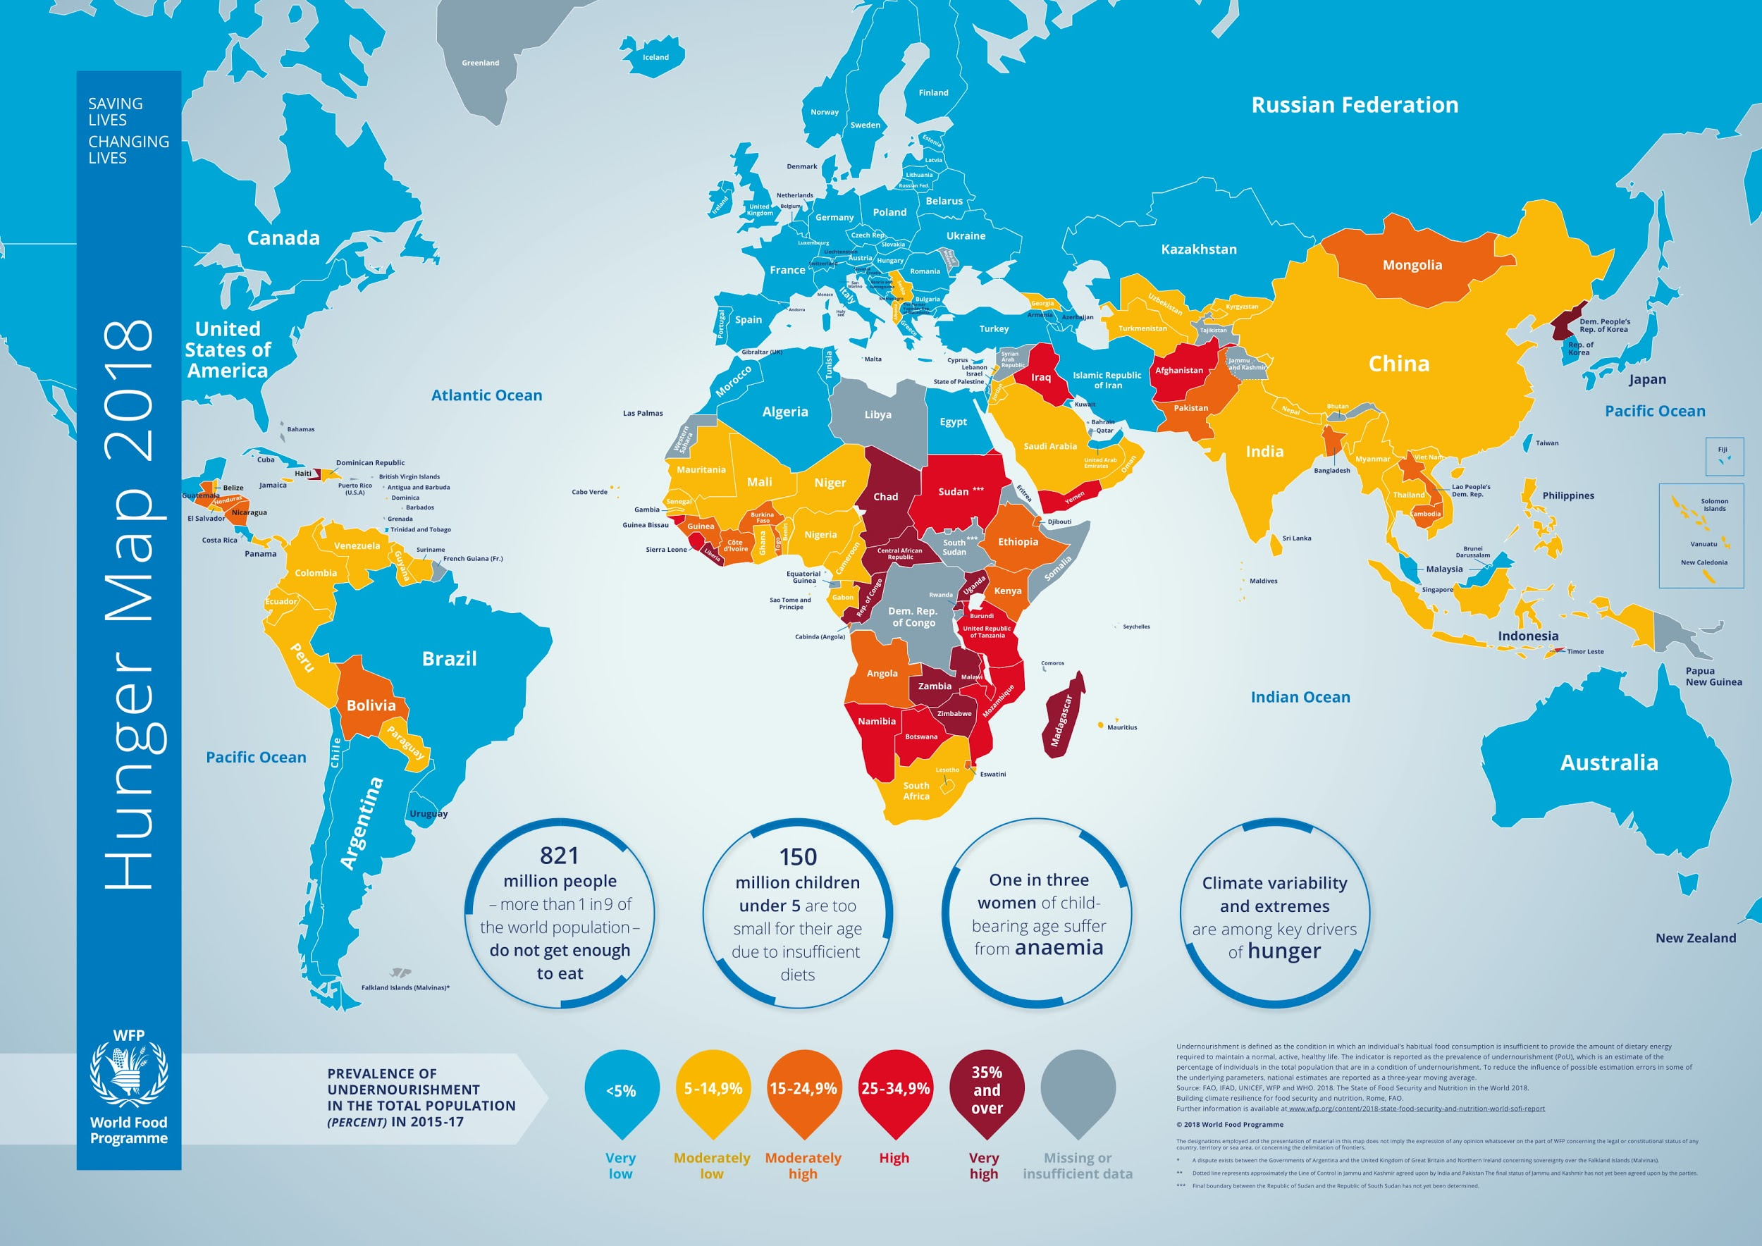
AFRICA Context:
Hunger
FAO, IFAD, UNICEF, WFP, and WHO. 2018. The State of Food Security and Nutrition in the World 2018.

Slide 59
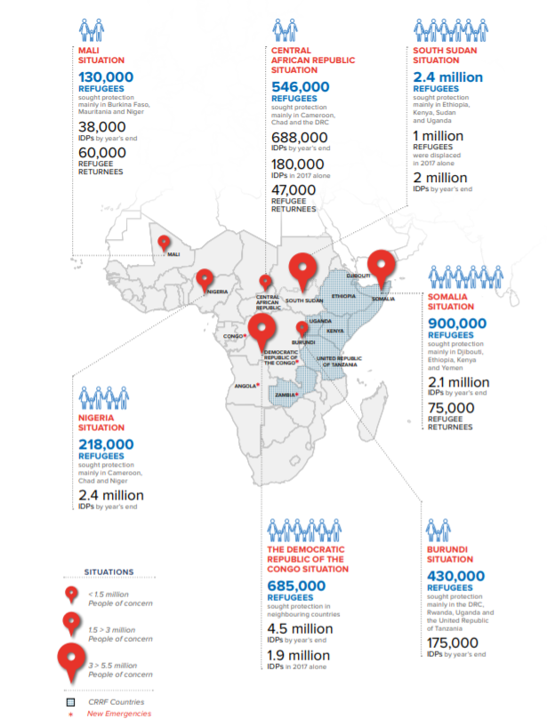
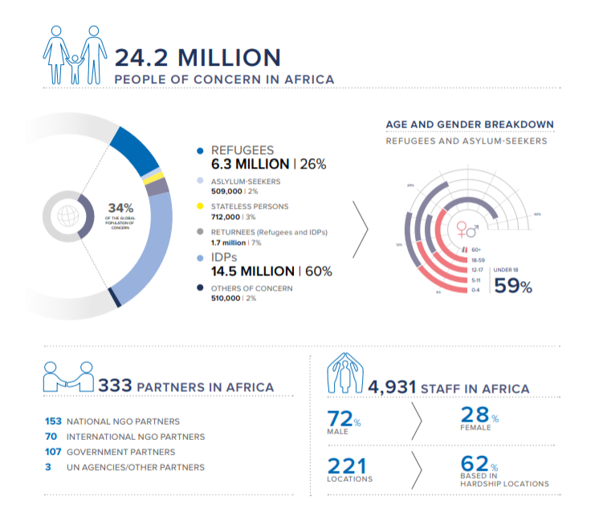
AFRICA Context:
Refugee Crises
  UNHCR Global Report, 2017
Notes:
Source: United Nations. (n.d.). UNHCR Global Report 2017 - Middle East and North Africa (MENA) regional summary.
Source: United Nations. (n.d.). UNHCR Global Report 2017 - Sub-Saharan Africa regional summary.

Slide 60
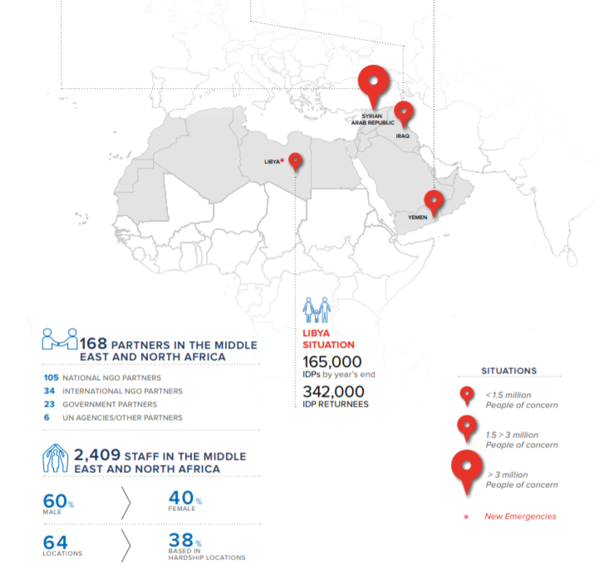
AFRICA Context:
Refugee Crises
  UNHCR Global Report, 2017

Slide 61
Final Wheat Score
 | Final Score Health + Implementation |  | Final Score Health + Implementation
Burundi | 3.85 | Zimbabwe | 6.33
Seychelles | 4.08 | Sudan | 6.43
Comoros | 4.73 | Liberia | 6.50
Ethiopia | 5.18 | Congo Rep. | 6.60
Rwanda | 5.33 | Sao Tome and Principe | 6.60
Lesotho | 5.38 | Zambia | 6.70
Mauritius | 5.53 | Namibia | 6.83
Eritrea | 5.58 | Sierra Leone | 6.85
Eswatini | 5.68 | Angola | 6.85
Libya | 5.70 | Botswana | 6.98
Equatorial Guinea | 5.90 | Gabon | 6.98
Madagascar | 6.08 | Tunisia | 7.03
DRC | 6.08 | Egypt | 7.50
Somalia | 6.10 | Algeria | 8.05
 |  | Morocco | 8.08
 |  | South Africa | 8.13

Slide 62
Final Maize Score
 | Final Score (Health + Implementation)
Burundi | 2.78
Malawi | 4.30
Rwanda | 4.70
Eswatini | 4.83
Lesotho | 4.98
Botswana | 5.08
Togo | 5.13
Uganda | 5.28
Cameroon | 5.35
Cabo Verde | 5.43
Benin | 5.75
Burkina Faso | 5.80
Tanzania | 5.88
Zimbabwe | 6.10
Zambia | 6.50
Namibia | 7.20
South Africa | 7.98

Slide 63
Final Rice Score
 | Final Score (Health + Implementation)
Comoros | 2.25
Mauritius | 3.75
Sao Tome and Principe | 3.88
Guinea-Bissau | 4.20
Mauritania | 4.50
Madagascar | 4.88
Gabon | 4.88
Egypt | 4.90
Guinea | 4.93
Nigeria | 5.03
Sierra Leone | 5.08
Cabo Verde | 5.15
Gambia | 5.30
Mali | 5.35
Djibouti | 5.38
Liberia | 5.50
Benin | 5.53
Cote d'Ivoire | 5.85
Senegal | 6.38
Ghana | 6.43

