Slide 1

Health Impact of Grain Fortification
Helena Pachón, PhD, MPH
Research Director
AFFORD Brown Bag Seminar
11 August 2023
Notes:
Hello everyone, my name is Helena Pachón and I am the Research Director for the Food Fortification Initiative.
I would like to thank Becky for inviting me to present on the health impact of grain fortification.

Slide 2
Main messages
Over 90 countries mandate grain fortification with a diversity of nutrients (we have effectiveness evidence for four of them)
Preponderance of the evidence suggests that
Fortifying grains with folic acid reduces the risk and severity of neural tube defects
Fortifying grains with folic acid is safe
Fortifying grains with iron, vitamin B12, and zinc improves nutritional status
Fortifying grains with nutrients involved in hemoglobin biology reduces anemia
Notes:
I’m going to start with the main messages I hope you get from this presentation.
Over 90 countries mandate grain fortification with a diversity of nutrients; however we only have effectiveness evidence for four of them
The preponderance of the evidence suggests that
Fortifying grains with folic acid reduces the risk and severity of neural tube defects,
Fortifying grains with folic acid is safe,
Fortifying grains with iron, vitamin B12, and zinc improves nutritional status, and
Fortifying grains with nutrients involved in hemoglobin biology reduces anemia.

Slide 3
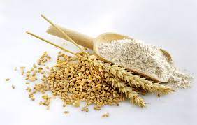

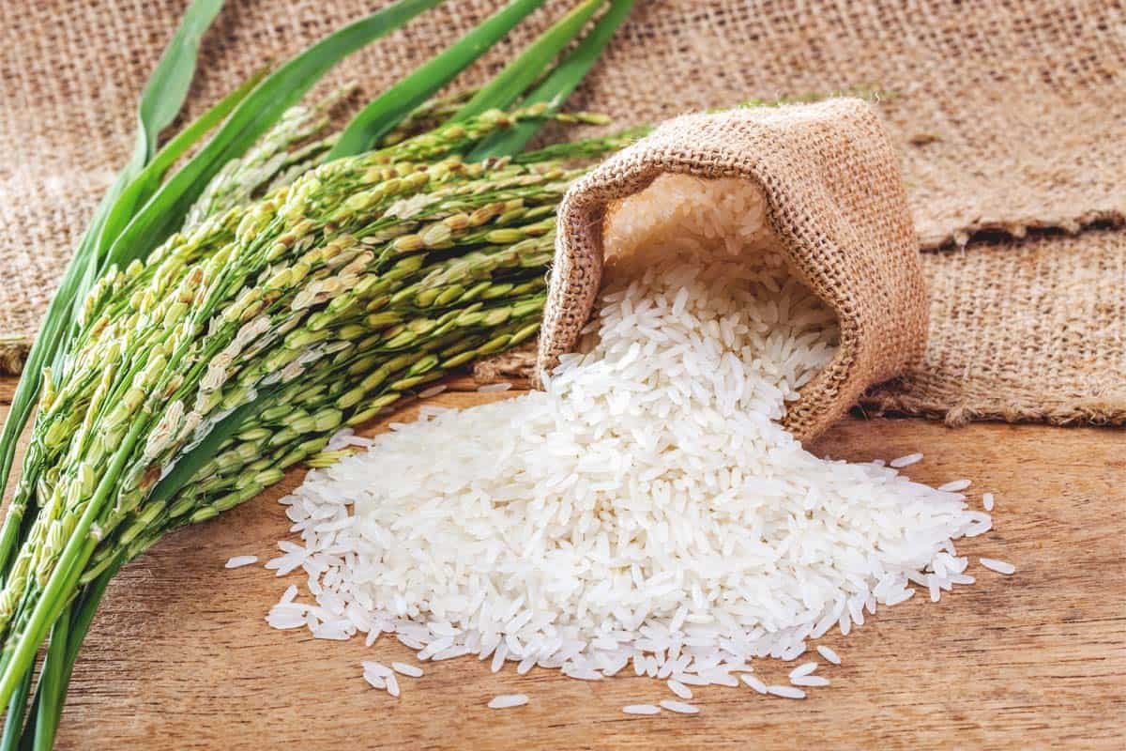
FFI supports fortification of wheat flour, maize flour and rice (grains)
Image
Image
Image
Provide 60% of the world’s food energy intake
https://www.fao.org/3/u8480e/u8480e07.htm
Notes:
FFI supports fortification of wheat flour, maize flour, and rice—the three most consumed foods in the world according to FAO.
We collectively refer to these three foods as grains.

Slide 4
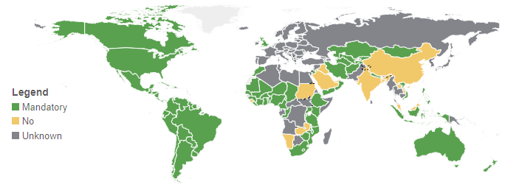
91 countries with mandatory wheat flour fortification
Nutrients in standards:
Ca, Fe, Se, Zn; vitamins A, B1, B2, B3, B6, B9, B12, D
Global Fortification Data Exchange: https://fortificationdata.org
Notes:
Currently, there are 91 countries with mandatory wheat flour fortification—those shown in green.
These countries require that one or more of the nutrients listed at the bottom of the slide be added to the flour.
Interestingly, there are only data on the effectiveness of four of these nutrients, as we’ll see later on.

Slide 5
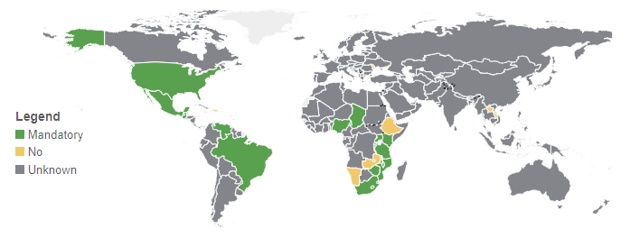
19 countries with mandatory maize flour fortification
Nutrients in standards:
Ca, Fe, Zn; vitamins A, B1, B2, B3, B6, B9, B12, D
Global Fortification Data Exchange: https://fortificationdata.org
Notes:
19 countries in the Americas and in Africa mandate maize flour fortification.
Nutrients in the standards are the same as for wheat flour, except for selenium which is not included in the standards for any countries with mandatory maize flour fortification.

Slide 6
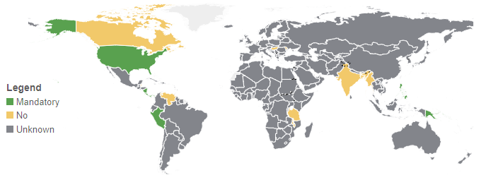
8 countries with mandatory rice fortification
Nutrients in standards:
Ca, Fe, Se, Zn; vitamins A, B1, B2, B3, B6, B9, B12, D, E
Global Fortification Data Exchange: https://fortificationdata.org
Notes:
Eight countries in the Americas and Asia mandate rice fortification.
Fortification standards include the same nutrients as wheat flour, with the addition of vitamin E.

Slide 7

Does grain fortification have a health impact?
Effectiveness studies
Real-life conditions
Image
Notes:
Randomized controlled trials, also known as efficacy studies, have confirmed that under ideal conditions, fortification has a health impact.
[CLICK TO ADVANCE] In this presentation, I am going to answer the same question, using evidence from effectiveness studies which are studies undertaken in real-life conditions, when grain fortification is implemented at large scale after mandatory legislation.

Slide 8

Biggest Success Story: Fortifying Grains with Folic Acid Reduces Neural Tube Defects and Their Severity
Image
Notes:
I will begin with the biggest success story we have in grain fortification: that’s the reduction in neural tube defects and their severity after adding folic acid to grains.

Slide 9
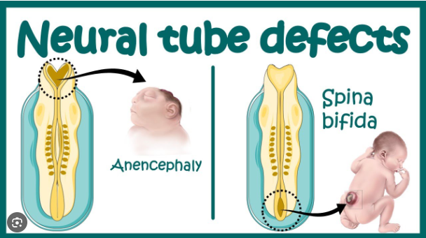
Neural tube defects and folic acid
Birth defects affecting the brain and spinal cord
Occurrence of neural tube defects (NTDs) yearly
260,100 global
~70% are preventable if the mother has enough folic acid around conception
Photo
Blencowe 2018; Czeizel 1992, MRC 1991
Image: http://www.thescienceofpregnancy.id.au
Notes:
Neural tube defects are a type of birth defect that affects the development of a baby’s brain and spine. The two most common forms of neural tube defects are pictured in the graph.
On the right you have spina bifida which is when the baby’s spine is not formed correctly. Spina bifida can be treated, but it cannot be cured, and these children have varying degrees of permanent disability for the rest of their lives.
On the left is anencephaly. This is when the brain is not formed correctly. All babies with anencephaly die shortly after birth.
[CLICK FOR ANIMATION] It is estimated that 260,100 babies are born with neural tube defects around the world every year.
Women need folic acid before conception and in the first few weeks after conception to prevent around 70% of these birth defects.
Reference:
Blencowe H, Kancherla V, Moorthie S, Darlison MW, Modell B. Estimates of global and regional prevalence of neural tube defects for 2015: a systematic analysis. Annals of the New York Academy of Sciences, 2018.
Czeizel AE, Dudás I. Prevention of the first occurrence of neural-tube defects by periconceptional vitamin supplementation. New England Journal of Medicine 1992;327(26):1832-5.
MRC Vitamin Study Research Group. Prevention of neural tube defects: results of the Medical Research Council Vitamin Study. Lancet 1991;338(8760):131-7.
9

Slide 10
Countries with mandatory grain fortification & folic acid in standards, by World Bank group
Countries | Low income | Lower-middle income | Upper-middle income | High income | Total
All | 19 | 22 | 19 | 9 | 69
Global Fortification Data Exchange: www.FortificationData.org
Notes:
Sixty-nine countries have mandatory fortification of wheat flour, maize flour or rice and include folic acid in their fortification standards.
These countries are mostly low- and middle-income according to the World Bank.

Slide 11
Countries with mandatory grain fortification & folic acid in standards, by World Bank group
Countries | Low income | Lower-middle income | Upper-middle income | High income | Total
All | 19 | 22 | 19 | 9 | 69
With neural tube defect data pre- and post-fortification | 0 | 0 | 7 Argentina Brazil Costa Rica Iran Jordan Peru South Africa | 6 Australia Canada Chile Oman Saudi Arabia USA | 13
n=41 studies
FFI: https://www.ffinetwork.org/savelives
Notes:
Thirteen of these 69 countries have studies comparing neural tube defects before and after mandatory fortification was enacted.
Most of these countries are upper-middle income and high-income according to the World Bank.
A total of 41 studies have been published across these countries.
All studies, except for one, report a decrease in neural tube defects after grain fortification with folic acid.
I will show you a few of these studies.

Slide 12
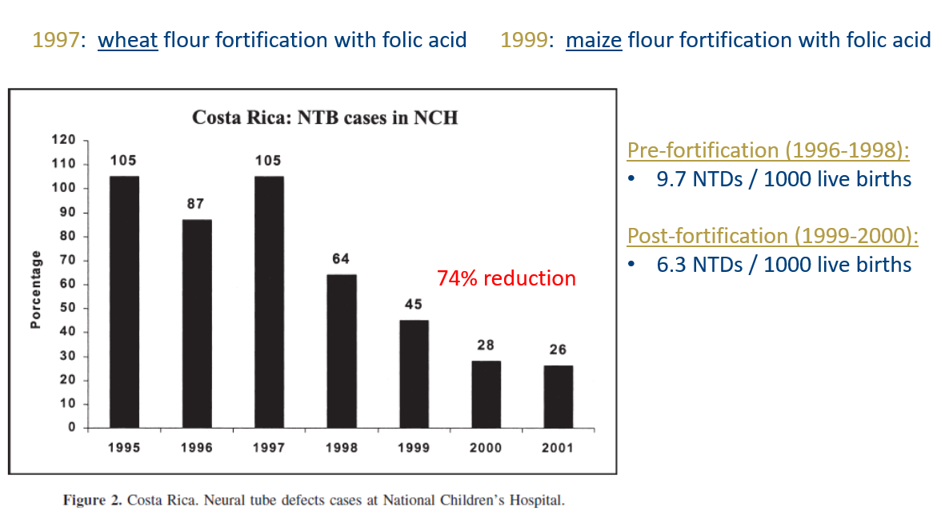
Fortification with folic acid reduces the risk of neural tube defects: Costa Rica
Tacsan Chen 2004
Notes:
Costa Rica began mandatory wheat flour fortification with folic acid and other nutrients in 1997 and the same for maize flour in 1999.
This graph shows the number of neural tube defect cases reported at the National Children’s Hospital between 1995 and 2001. We can observe the downward trend in cases, representing a 74% reduction through fortification with folic acid.
--
Source:
Luis Tacsan Chen & Melany Ascencio Rivera. The Costa Rican Experience: Reduction of Neural Tube Defects following Food Fortification Programs. Nutrition Reviews. 2004.

Slide 13
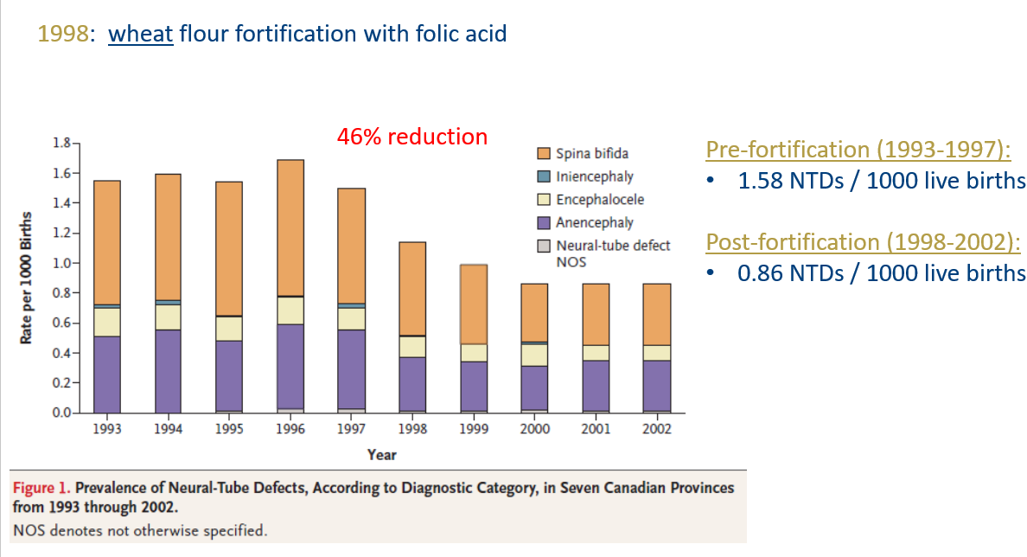
Fortification with folic acid reduces the risk of neural tube defects: Canada
De Wals 2007
Notes:
Canada mandated wheat flour fortification with folic acid and other nutrients to begin in 1998.
This graph shows the prevalence per 1000 births of babies with different neural tube defects. For example, orange represents spina bifida and purple represents anencephaly. The height of each bar represents the total number of neural tube defects per 1000 births.
Between 1993 and 2002, there was a 46% reduction in neural tube defects because of fortification with folic acid.
--
Source:
Philippe De Wals et al. Reduction in Neural-Tube Defects after Folic Acid Fortification in Canada. N Engl J Med 2007;357:135-42.

Slide 14
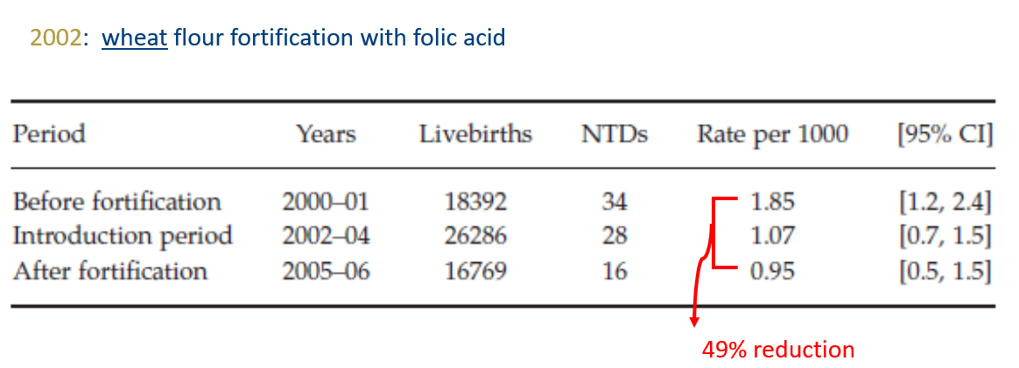
Fortification with folic acid reduces the risk of neural tube defects: Jordan
Amarin 2010
Notes:
Jordan began mandatory fortification of wheat flour with folic acid and other nutrients in 2002.
Researchers reported neural tube defects for three time periods: before fortification, during the early years of fortification (that is, the “introduction period”), and after several years of fortification (called “after fortification”).
Neural tube defects were reduced 49% through fortification with folic acid.
--
Source:
Amarin, Zouhair O., and Ahmed Z. Obeidat. "Effect of folic acid fortification on the incidence of neural tube defects." Paediatric and perinatal epidemiology 24.4 (2010): 349-351.

Slide 15
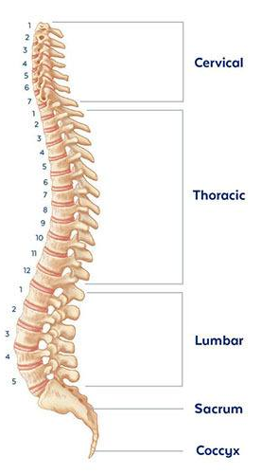
Spina bifida severity is decreased after mandatory fortification with folic acid
The higher the lesion, the greater the disability and mortality risk
In the US, higher-level (more severe) spina bifida lesions decreased from 24.6% to 8.8% after mandatory fortification with folic acid
Image
Mai 2022
Notes:
Here we have an image of the spine: the skull would be at the top.
The higher the lesion (or defect) is along the spine, the greater the disability and mortality risk. Therefore, the lower the lesions are on the spine, the greater functionality and quality of life for the individual.
[CLICK TO ADVANCE] After mandatory grain fortification with folic acid in the US, higher-level spina bifida lesions decreased from 25% to 9%. This suggests greater quality of life for individuals who are born with spina bifida.
--
Mai CT, Evans J, Alverson CJ, et al. Changes in Spina Bifida Lesion Level after Folic Acid Fortification in the US. J Pediatr. 2022;249:59-66.e1.
Lower-level (less severe) spina bifida lesions increased from 69.8% to 84.6% from the pre- to the post-fortification periods.

Slide 16
Fortification with folic acid reduces the risk of neural tube defects: meta-analysis
All Neural Tube Defects
Odds Ratio: 0.59 (95% CI: 0.49, 0.70)
n=19,816,008 births (reported in 8 studies)
41% reduction in the odds of neural tube defects after grain fortification with folic acid
Keats 2019
Notes:
Next we’ll look at meta-analysis studies.
Keats and colleagues summarized eight studies like the previous ones, with almost 20 million births, and found a 41% reduction in the odds of neural tube defects after grain fortification with folic acid.
--
Source:
Keats EC, Neufeld LM, Garrett GS, Mbuya MNN, Bhutta ZA. Improved micronutrient status and health outcomes in low- and middle-income countries following large-scale fortification: evidence from a systematic review and meta-analysis. Am J Clin Nutr. 2019 Jun 1;109(6):1696-1708.

Slide 17
Spina bifida is lower in countries with mandatory policies to fortify with folic acid
n=161 studies
Atta 2016
Notes:
Atta and colleagues completed a meta-analysis with many more studies: 161. They looked at one type of neural tube defect: spina bifida.
[CLICK TO ADVANCE] They looked at spina bifida in three different groups observed in the first column: among live births; among live births and still births; and then among live births, still births and terminations combined.
[CLICK TO ADVANCE] They then calculated the percent of babies with spina bifida in countries with mandatory fortification that included folic acid (this is in column 3).
[CLICK TO ADVANCE] They also calculated the percent of babies born with spina bifida in countries that had no mandatory fortification (this is in the last column).
The percent of babies with spina bifida was always lower in countries with mandatory fortification compared to countries with no mandatory fortification.
[CLICK TO ADVANCE] For example, in the first row, the prevalence of spina bifida was 33.86 per 100,000 live births in countries with mandatory fortification compared with 48.35 per 100,000 live births in countries without mandatory fortification.
--
Reference:
Atta CA, Fiest KM, Frolkis AD, Jette N, Pringsheim T, St Germaine-Smith C et al. Global birth prevalence of spina bifida by folic acid fortification status: a systematic review and meta-analysis. American Journal of Public Health 2016;106:e24-34.

Slide 18
Systematic review: fortification with folic acid reduces neural tube defects
NTD, neural tube defect
Castillo-Lancellotti 2013
Notes:
The third type of study we’ll look at are systematic reviews.
A 2013 systematic review assessed the impact of folic acid fortification of flour on neural tube defects.
Studies were obtained from nine countries: Chile, Argentina, Brazil, Canada, Costa Rica, Iran, Jordan, South Africa and the USA.
A total of 27 studies were included.
The authors concluded that “Fortification of flour with folic acid has had a major impact on [neural tube defects] in all countries where this has been reported.”
--
Source:
Castillo-Lancellotti C, Tur JA, Uauy R. Impact of folic acid fortification of flour on neural tube defects: a systematic review. Public Health Nutr. 2013 May;16(5):901-11. doi: 10.1017/S1368980012003576. Review. Erratum in: Public Health Nutr. 2013 Aug;16(8):1527

Slide 19
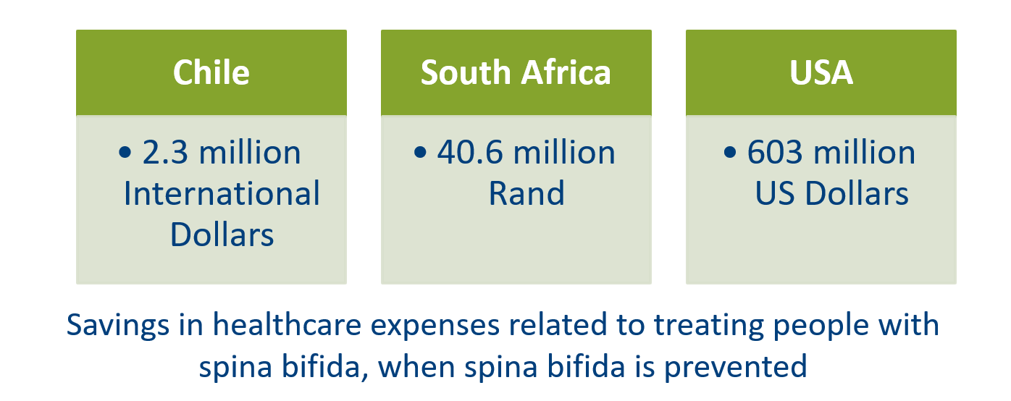
Fortification with folic acid is cost-effective in reducing the risk of neural tube defects
Annual Net Savings from Adding Folic Acid to Grains
Llanos 2007, Sayed 2008, Grosse 2016
Notes:
Three countries have compared the costs of adding folic acid to grains with the costs of treating people with spina bifida.
Each study showed significant net savings in healthcare expenses when spina bifida is prevented: 2.3 million international dollars in Chile, 40.6 million Rand in South Africa and 603 million US dollars in the USA.
Notice that these are annual savings, so every year of fortification leads to these net savings.
--
Source:
Llanos et. al., Cost-effectiveness of a Folic Acid Fortification Program in Chile. Health Policy 83 2007:295-303.
Sayed et.al., Decline in the Prevalence of Neural Tube Defects Following Folic Acid Fortification and Its Cost-Benefit in South Africa. Birth Defects Research 82 2008:211-216.
Grosse et. al., Retrospective Assessment of Cost Savings From Prevention. American Journal of Preventive Medicine , 2016.

Slide 20

61,680 Neural Tube Defects Prevented Annually
Globally an estimated 61,680 birth defects were prevented in 2020
– an average of 169 a day –
where grains were fortified with folic acid
istock
Kancherla 2022
Notes:
Fundamentally, we’re helping to save babies lives through fortification.
Globally an estimated 61,680 birth defects were prevented in 2020 where grains were fortified with folic acid.
This represents an average of 169 babies per day being born free of neural tube defects.
Source:
Kancherla V, Wagh K, Priyadarshini P, Pachon H, Oakley GP Jr. A global update on the status of prevention of folic acid-preventable spina bifida and anencephaly in year 2020: 30-year anniversary of gaining knowledge about folic acid’s prevention potential for neural tube defects. Birth Defects Res. 2022; 114: 1392-1403.

Slide 21

Summary
Fortifying grains with folic acid reduces the risk and severity of neural tube defects
Supported by pre-post data from countries, meta-analyses, systematic reviews, economics studies, modeling studies
Photo
Notes:
In summary, fortifying grains with folic acid reduces the risk and severity of neural tube defects.
This is supported by pre-post data from countries, meta-analyses, systematic reviews, and economics and modeling studies.

Slide 22

Concerns about fortifying food with folic acid
Image
Notes:
In addition to enthusiasm over lives saved with folic acid fortification, there are concerns about potential negative health impacts of fortifying with this vitamin.

Slide 23
Fortifying food with folic acid does not mask vitamin B12 deficiency
Notes:
Let’s start by reviewing evidence that fortifying food with folic acid does not mask vitamin B12 deficiency.

Slide 24
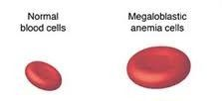
Folate and vitamin B12 deficiencies cause megaloblastic anemia
Folate deficiency
Vitamin B12 deficiency
Causes
Causes
Megaloblastic Anemia
IOM 2000
Megaloblastic anemia is the same as macrocytic anemia
Notes:
Folate deficiency independently causes megaloblastic anemia, that is anemia where the red blood cells are much larger than normal. As you know, anemia is an important public health problem in many countries.
[CLICK TO ADVANCE] Vitamin B12 deficiency also independently causes megaloblastic anemia.
--
Source:
Institute of Medicine. Dietary Reference Intakes for Thiamin, Riboflavin, Niacin, Vitamin B6, Folate, Vitamin B12, Pantothenic Acid, Biotin, and Choline. 2000.
Megaloblastic anemia image: https://i.pinimg.com/236x/47/41/e6/4741e6ce99437a3260364ed6001b9ddf--macrocytic-anemia-b-deficiency.jpg

Slide 25
Folic acid masking of vitamin B12 deficiency
Megaloblastic anemia due to vitamin B12 deficiency only
If folic acid is provided
If vitamin B12 is not provided
Anemia is corrected
Vitamin B12 deficiency persists
“folic acid masking of vitamin B12 deficiency”
Berry 2019
Notes:
Let’s say a person has megaloblastic anemia due to vitamin B12 deficiency only. This is often observed in older adults because they no longer absorb vitamin B12 from the diet as well as they did when they were younger.
In these individuals, if folic acid is provided, the anemia is corrected.
[CLICK TO ADVANCE] However, if vitamin B12 is not provided to them, then their vitamin B12 deficiency can persist and with it, potentially irreversible neurological conditions such as memory loss, disorientation and frank dementia.
[CLICK TO ADVANCE] The fact that folic acid can correct megaloblastic anemia while not treating the underlying vitamin B12 deficiency is known as “folic acid masking of vitamin B12 deficiency.”
--
Source:
RJ Berry. Lack of historical evidence to support folic acid exacerbation of the neuropathy caused by vitamin B12 deficiency. American Journal of Clinical Nutrition 2019.

Slide 26
Study to assess if fortification with folic acid causes masking of vitamin B12 deficiency
People with vitamin B12 deficiency and no anemia who consume food fortified with folic acid
Folic acid is provided
Vitamin B12 is not provided
Anemia does not develop
Vitamin B12 deficiency develops
Mills 2003, Qi 2014
Notes:
Researchers from the US surmised that people with vitamin B12 deficiency and no anemia who consumed food fortified with folic acid could be at risk of vitamin B12 deficiency going untreated.
In other words, in these individuals, since folic acid is provided through grain fortification in the USA, they will not develop anemia.
However, since vitamin B12 is not provided through grain fortification in the USA, their vitamin B12 deficiency will persist.
--
Source:
Mills JL et al. Low vitamin B-12 concentrations in patients without anemia: the effect of folic acid fortification of grain. Am J Clin Nutr 2003;77:1474–7.
Yan Ping Qi, Ann N. Do, Heather C. Hamner, Christine M. Pfeiffer, and Robert J. Berry. The prevalence of low serum vitamin B-12 status in the absence of anemia or macrocytosis did not increase among older U.S. adults after mandatory folic acid fortification. J. Nutr. 144: 170–176, 2014.

Slide 27
Fortification with folic acid does not mask vitamin B12 deficiency
People with vitamin B12 deficiency and no anemia who consume food fortified with folic acid
Folic acid is provided
Vitamin B12 is not provided
Anemia does not develop
Vitamin B12 deficiency develops
If fortification with folic acid masks vitamin B12 deficiency, the percentage of individuals with vitamin B12 deficiency but no anemia should increase after fortification with folic acid
Study | Pre-fortification | Post-fortification | Conclusion
Mills 2003 | 39.2% | 37.6% | No masking of vitamin B12 deficiency
Qi 2014 | 4.0% | 3.9% | No masking of vitamin B12 deficiency
Mills 2003, Qi 2014
Notes:
If fortification with folic acid masks vitamin B12 deficiency, the percentage of people with vitamin B12 deficiency but no anemia should increase after fortification starts.
[CLICK TO ADVANCE] Two studies have been conducted on this topic, with data from the United States. They show the contrary—the prevalence of individuals with vitamin B12 deficiency and no anemia, did not change between the pre- and post-fortification periods, suggesting that fortification with folic acid does not mask vitamin B12 deficiency.
--
Source:
Mills JL et al. Low vitamin B-12 concentrations in patients without anemia: the effect of folic acid fortification of grain. Am J Clin Nutr 2003;77:1474–7.
Yan Ping Qi, Ann N. Do, Heather C. Hamner, Christine M. Pfeiffer, and Robert J. Berry. The prevalence of low serum vitamin B-12 status in the absence of anemia or macrocytosis did not increase among older U.S. adults after mandatory folic acid fortification. J. Nutr. 144: 170–176, 2014.

Slide 28
Free folic acid in the blood does not increase adenoma risk
Adenomas are benign tumors that can develop into cancer
“Free folic acid” is also referred to as “unmetabolized folic acid”
Notes:
Next we will review evidence that free folic acid in the blood does not increase the risk of adenomas.

Slide 29
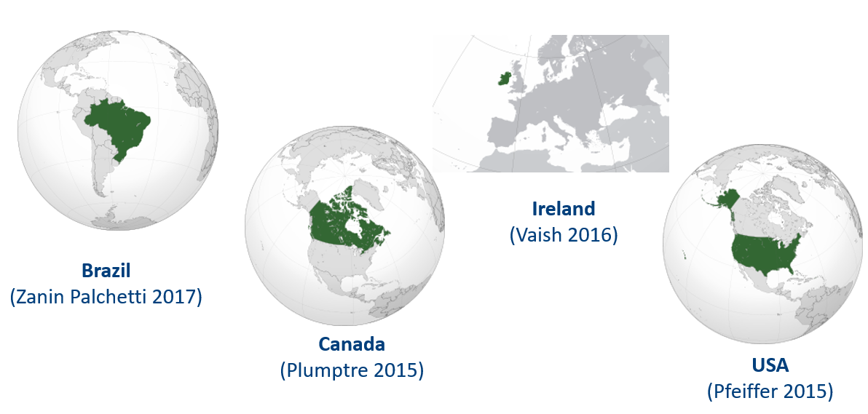
After folic acid consumption, free folic acid appears in the blood
“Free folic acid” is also referred to as “unmetabolized folic acid”
Notes:
Evidence from several countries with mandatory or voluntary food fortification with folic acid shows that free folic acid appears in the blood after folic acid consumption.
This has been observed, for example, in Brazil, Canada, Ireland and the USA.
--
Source:
Bailey R et al. Unmetabolized serum folic acid and its relation to folic acid intake from diet and supplements in a nationally representative sample of adults aged >60 y in the United States. Am J Clin Nutr 2010;92:383–9.
Boilson A et al. Unmetabolized folic acid prevalence is widespread in the older Irish population despite the lack of a mandatory fortification program. Am J Clin Nutr 2012; doi: 10.3945/ajcn.111.026633
Pfeiffer CM et al. Unmetabolized Folic Acid Is Detected in Nearly All Serum Samples from US Children, Adolescents, and Adults. J Nutr 2015;145:520–31.
Plumptre L et al. High concentrations of folate and unmetabolized folic acid in a cohort of pregnant Canadian women and umbilical cord blood. Am J Clin Nutr 2015;102:848–57.
Vaish 2016 et al. Synthetic folic acid intakes and status in children living in Ireland exposed to voluntary fortification. Am J Clin Nutr 2016;103:512–8.
Zanin Palchetti C et al. Association between Serum Unmetabolized Folic Acid Concentrations and Folic Acid from Fortified Foods. JOURNAL OF THE AMERICAN COLLEGE OF NUTRITION 2017, VOL. 36, NO. 7, 572–578. [Study conducted in Brazil].
Source for maps: wikipedia

Slide 30
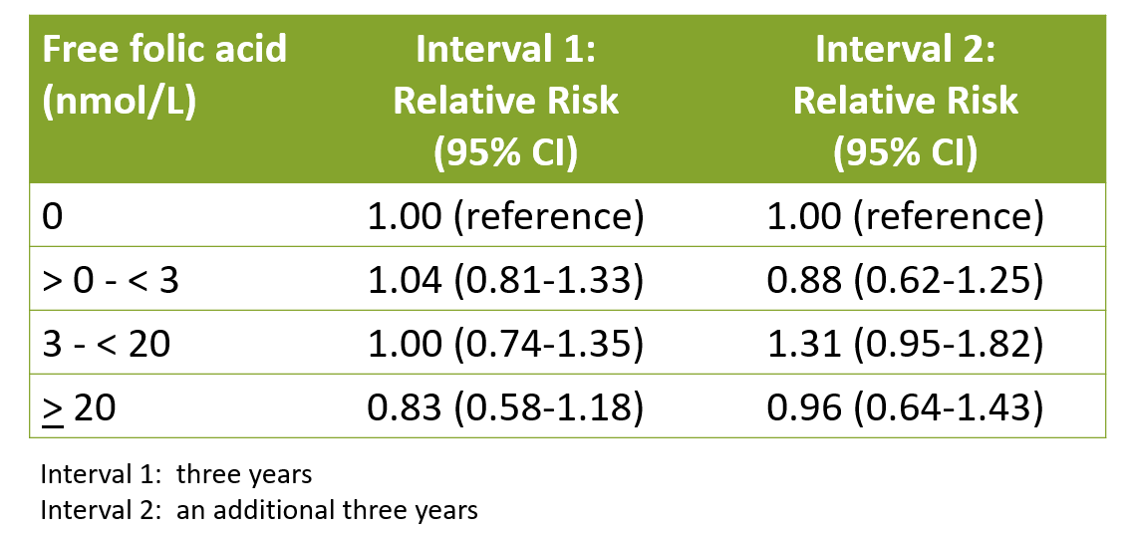
Free folic acid does not increase the risk of adenomas
Relationship between Free Folic Acid In Blood and Risk of Developing Colorectal Adenomas
Adenomas are benign tumors that can develop into cancer
“Free folic acid” is also referred to as “unmetabolized folic acid”
Rees 2017
Notes:
This study examined if there was a relationship between free folic acid in blood and the risk of getting colorectal adenomas, which are benign tumors that can develop into cancer.
Study participants were followed for two periods: interval one which was three years long and interval two which was an additional three years.
In the first column, they divided up the free folic acid levels in blood into four categories ranging from 0 nanomoles per liter to 20 nanomoles per liter or greater.
They then calculated the relative risk to determine if there was any relationship between free folic acid levels in blood and the risk of developing adenomas.
For intervals 1 and 2, all of the relative risks with their 95% confidence intervals include 1. This means that free folic acid levels in blood do not increase the risk of adenomas.
--
Source:
Rees JR et al. Unmetabolized Folic Acid, Tetrahydrofolate, and Colorectal Adenoma Risk. Cancer Prev Res; 10(8); 451–8. 2017.

Slide 31

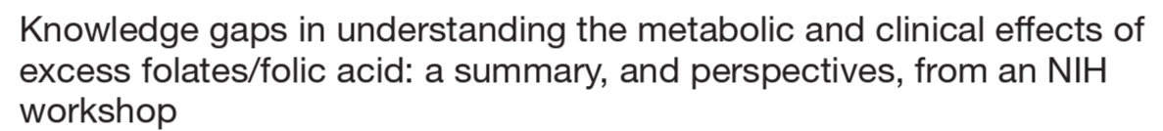
“Observations indicating adverse effects from excess folic acid intake, elevated folate status, and unmetabolized folic acid (UMFA) remain inconclusive; the data do not provide the evidence needed to affect public health recommendations.”
NIH, National Institutes of Health
Maruvada 2020
Notes:
This article summarizes the proceedings of a 2019 expert workshop held at the National Institutes of Health.
This quote is taken from the abstract: “Observations indicating adverse effects from excess folic acid intake, elevated folate status, and unmetabolized folic acid (UMFA) remain inconclusive; the data do not provide the evidence needed to affect public health recommendations.”
--
Maruvada P, Stover PJ, Mason JB, et al. Knowledge gaps in understanding the metabolic and clinical effects of excess folates/folic acid: a summary, and perspectives, from an NIH workshop. Am J Clin Nutr. 2020;112(5):1390-1403.

Slide 32
Fortifying food with folic acid does not cause cancer or increase deaths from cancer
Notes:
Now, let’s review evidence that fortifying food with folic acid does not cause cancer or increase deaths from cancer.

Slide 33
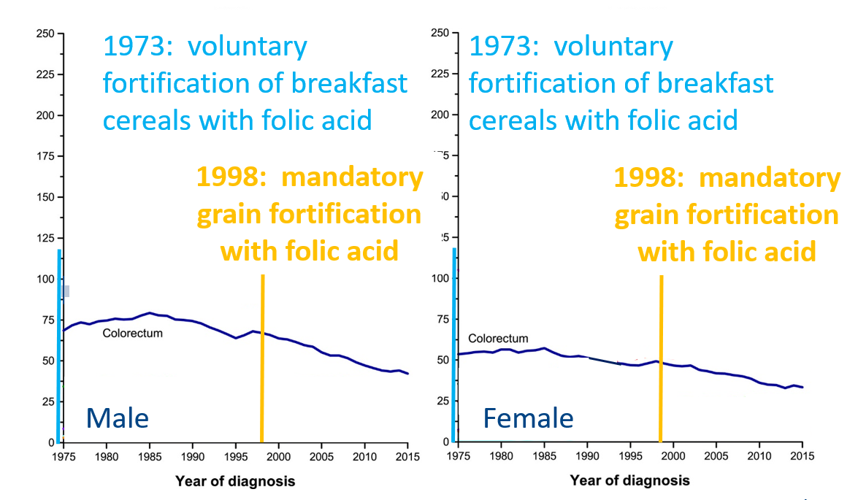
Fortification with folic acid does not cause cancer
Colorectal Cancer Rate per 100,000 Population, USA
Siegel 2019
Notes:
Here we have two graphs with the rate of colorectal cancer per 100,000 population in the United States. As you can see in the horizontal axes, the year of cancer diagnosis ranges from 1975 to 2015.
During this period, voluntary fortification of breakfast cereals with folic acid began in 1973 and mandatory fortification of grains with folic acid became effective in 1998.
The left-hand side has the data for males and the right-hand side has the data for females.
For both women and men, the dark blue line shows a reduction in the number diagnosed with colorectal cancer during this period.
There is no evidence that fortification with folic acid increases the number of people being diagnosed with colorectal cancer.
--
Source:
Siegel R et al. Cancer statistics, 2019. CA: A Cancer Journal for Clinicians. 2019.

Slide 34
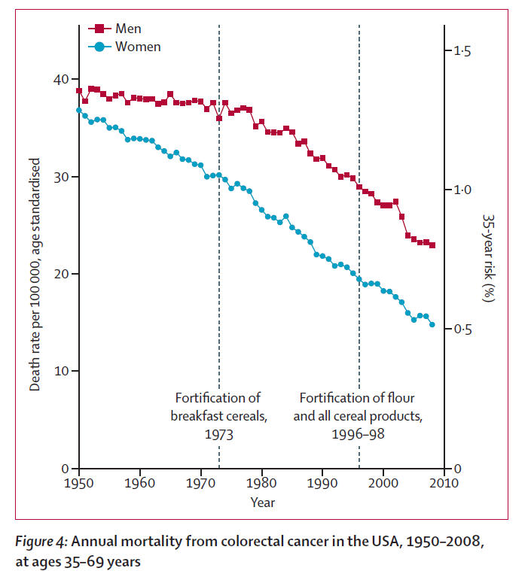
Fortification with folic acid does not increase deaths from cancer
Vollset 2013
Notes:
A related question is whether more people are dying from colorectal cancer due to fortification with folic acid.
Researchers reviewed data on the annual mortality in the United States from colorectal cancer from 1950 to 2010, which is the timeline that appears along the horizontal axis. They note in the dashed vertical lines that voluntary fortification of breakfast cereals began in 1973 and that mandatory grain fortification with folic acid became effective in 1998.
The data are presented for men in red and women in blue.
For both women and men, there was a decrease in annual deaths from colorectal cancer over this 60-year period.
These data suggest that folic-acid fortification does not increase deaths from colorectal cancer.
--
Source:
Vollset SE et al. Effects of folic acid supplementation on overall and site-specific cancer incidence during the randomised trials: meta-analyses of data on 50 000 individuals. Lancet January 25, 2012. http://dx.doi.org/10.1016/S0140-6736(12)62001-7.

Slide 35
Summary
Fortifying grains with folic acid does not
Mask vitamin B12 deficiency
Increase adenoma* risk
Cause cancer or increase deaths from cancer
*Adenomas are benign tumors that can develop into cancer
Notes:
In summary, fortifying grains with folic acid
Does not mask vitamin B12 deficiency,
Does not increase adenoma risk, and
Does not cause cancer or increase deaths from cancer.

Slide 36

Other health improvements attributable to fortified grains
Image
Notes:
Preventing neural tube defects through fortification is a great achievement.
In addition, there are other health improvements attributable to fortified grains.

Slide 37
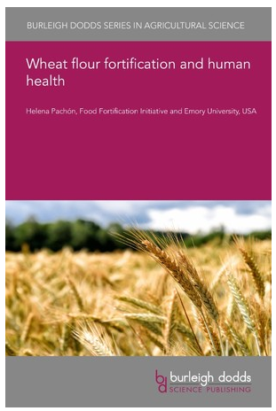
Studies completed after a country implemented mandatory wheat flour fortification
https://www.bdschapters.com/webshop/open-access/wheat-flour-fortification-and-human-health/
Notes:
I’m going to begin by sharing a summary of studies that were completed after a country implemented mandatory wheat flour fortification.
These results are in a book chapter I wrote which was published in 2021.
You can download a free copy of the chapter at the link found at the bottom of this slide.

Slide 38
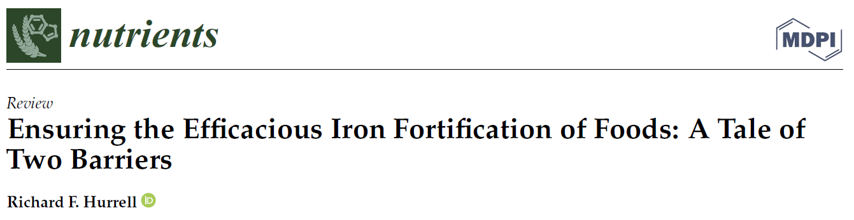
BIS, body iron stores; sTfR, soluble transferrin receptor
Pachón 2021, Hurrell 2022
Notes:
This first slide summarizes studies that looked at 8 different outcomes of iron status before and after flour fortification with iron. These are listed across the horizontal axis and from the left they are iron status measured using serum or plasma ferritin, iron status measured using soluble transferrin receptor, iron status measured using body iron stores, the prevalence of iron deficiency, the prevalence of iron deficiency due to low ferritin, the prevalence of iron deficiency due to high soluble transferrin receptor, the prevalence of iron deficiency due to low body iron stores, and the prevalence of iron-deficiency anemia.
Per the legend at the top, green indicates a study showed an improvement in the outcome such as an increase in ferritin or a decrease in iron deficiency, blue indicates there was no change from the pre- to the post-fortification period, and yellow means the outcome got worse, such as an increase in the prevalence of iron deficiency.
Overall, most outcomes showed an improvement: 23 of 34. The exception was iron-deficiency anemia where some studies showed no effect and one found an increase in the prevalence of iron-deficiency anemia after fortification.
[CLICK TO ADVANCE] Richard Hurrell posits that some of the null results we’ve been observing for any food fortified with iron can be because of high inflammation load, which does not allow dietary iron to be absorbed.
--
Pachon 2021. Wheat flour fortification and human health. https://www.bdschapters.com/webshop/open-access/wheat-flour-fortification-and-human-health/
Hurrell, R.F. Ensuring the Efficacious Iron Fortification of Foods: A Tale of Two Barriers. Nutrients 2022, 14, 1609.
Iron deficiency/made no difference results (n=4):
Pachón et al. 2015: no difference in the prevalence of low ferritin in post-fortification and prefortification period in children.
Fothergill 2019: Prevalence of low serum ferritin did not differ by intake of wheat flour-containing foods (women)
Fothergill 2019: Prevalence of low serum ferritin did not differ by intake of wheat flour-containing foods (children 2-4 y and 5-12 y)
Hund 2013: Prevalence of iron depletion did not differ by household possession of flour that should be fortified and bread that should be fortified (women)
Iron deficiency (low ferritin)/made no difference results (n=2):
Engle-Stone 2017: No difference in prevalence of low plasma ferritin (women) between post-fortification and pre-fortification period,
Layrisse 2002: no difference in prevalence of low serum ferritin in post-fortification and pre-fortification period
Iron-deficiency anemia/made no difference results (n=4):
Engle-Stone 2017: No difference in prevalence of iron-deficiency anemia (women) between post-fortification and pre-fortification period
Engle-Stone 2017: No difference in prevalence of iron-deficiency anemia (children 12-59 mo) between post-fortification and pre-fortification period
Layrisse 1996: No difference in prevalence of iron-deficiency anemia in post-fortification and pre-fortification period (children and adolescents)
Sadighi 2008: No difference between the pre-and post-fortification periods in the prevalence of iron-deficiency anemia (women)
Iron-deficiency anemia/worsened results (n=1):
Sadighi 2009: Prevalence of iron-deficiency anemia higher in post-fortification than pre-fortification period (women)
Hurrell 2022:
“development of an inflammation barrier as a defense mechanism to prevent circulating iron from exacerbating infections.”
“Iron absorption and distribution to the tissues are under the strict control of the
hormone hepcidin, which balances the need for iron with the potential of iron to cause
harm. Hepcidin controls dietary iron absorption by regulating the entry of dietary iron
from the duodenal enterocytes into the plasma, and it controls iron distribution to the
tissues by regulating the passage of recovered red cell iron from the reticuloendothelial
macrophages into the plasma. Hepcidin expression is downregulated by low iron status,
increasing iron absorption and increasing iron distribution when the body needs more
iron, and hepcidin expression is upregulated by an adequate iron status and high iron
stores, decreasing iron absorption and distribution when the need for iron is low. However,
hepcidin expression is also upregulated by inflammation, caused by infections, so as to
block the pathogen’s access to iron.”

Slide 39
Pachón 2021
Notes:
There are few studies that reported on vitamin B12 outcomes; they all showed an improvement after flour fortification with vitamin B12.
--
Pachon 2021. Wheat flour fortification and human health. https://www.bdschapters.com/webshop/open-access/wheat-flour-fortification-and-human-health/

Slide 40
Pachón 2021
Notes:
Similarly, there are few studies that reported on zinc outcomes and they all showed an improvement after flour fortification with zinc.
--
Pachon 2021. Wheat flour fortification and human health. https://www.bdschapters.com/webshop/open-access/wheat-flour-fortification-and-human-health/

Slide 41
Anemia reduction after mandatory grain fortification
21 Countries with > 2 Demographic and Health Surveys with hemoglobin measurements
10 (mandatory grain fortification with nutrients involved in hemoglobin biology)
11 (no fortification)
971,318 women with anemia data
Controlled for individual, household and country-level factors that could affect anemia
Anemia prevalence was lower after grain fortification was mandated
Odds Ratio (95% Confidence Interval)
0.73 (0.63, 0.85)
27% reduced odds of anemia in countries before and after fortification was mandated, compared to control countries where there was no difference in anemia between surveys
Rondini 2022
Notes:
In closing I’d like to share research we published last year.
This analysis included data from 21 countries that had at least two nationally representative surveys with hemoglobin measurements in women. 10 of these countries mandated grain fortification in between the two surveys and the fortification standards included nutrients involved with hemoglobin biology. 11 countries did not mandate fortification in between the surveys.
[CLICK TO ADVANCE] There were data from almost 1 million women in the analysis.
[CLICK TO ADVANCE] The analysis controlled for factors that could affect a woman’s hemoglobin such as whether she takes oral contraceptives, if she lives in an urban or rural setting, and her country’s gross domestic product.
[CLICK TO ADVANCE] After controlling for these factors, anemia prevalence was lower in countries that mandated grain fortification than those that did not.
[CLICK TO ADVANCE] There was a 27% reduced odds of anemia in countries before and after fortification was mandated, compared to control countries where there was no difference in anemia between surveys.
While we can’t say with certainty from this study that fortification reduced anemia, these results suggest that grain fortification contributed to this reduction.
--
Rondini KA, Xu W, Chai Y, Pachón H, Kancherla V. National Mandatory Grain Fortification Legislation Decreases Anemia Prevalence among Nonpregnant Women of Reproductive Age: Findings from Multiple Demographic and Health Surveys. J Nutr. 2023;152(12):2922-2930.
Keats and colleagues in 2019 reported a 0.66 relative risk for anemia reduction after fortification using data from 132,000 women in 9 studies.

Slide 42

Summary
Evidence from large-scale implementation
Fortifying grains with iron, vitamin B12, and zinc improves nutritional status
Fortifying grains with nutrients involved in hemoglobin biology reduces anemia
Photo
Notes:
To summarize the last part of the presentation:
We have evidence from the large-scale implementation of grain fortification that suggests that fortifying grains with iron, vitamin B12 and zinc improves nutritional status, and that fortifying grains with nutrients involved in hemoglobin biology reduces anemia.

Slide 43
Main messages
Over 90 countries mandate grain fortification with a diversity of nutrients (we have effectiveness evidence for four of them)
Preponderance of the evidence suggests that
Fortifying grains with folic acid reduces the risk and severity of neural tube defects
Fortifying grains with folic acid is safe
Fortifying grains with iron, vitamin B12, and zinc improves nutritional status
Fortifying grains with nutrients involved in hemoglobin biology reduces anemia
Notes:
In closing, I hope to have convinced you that
Over 90 countries mandate grain fortification with a diversity of nutrients; however we only have effectiveness evidence for four of them
The preponderance of the evidence suggests that
Fortifying grains with folic acid reduces the risk and severity of neural tube defects,
Fortifying grains with folic acid is safe,
Fortifying grains with iron, vitamin B12, and zinc improves nutritional status, and
Fortifying grains with nutrients involved in hemoglobin biology reduces anemia.

Slide 44


For more information:
www.FFInetwork.org
www.Facebook.com/FFInetwork
https://twitter.com/FFINetwork
Join the Food Fortification Initiative group on Linked In
Contact:
Helena.Pachon@emory.edu
SMARTER
STRONGER
HEALTHIER
Notes:
I would be happy to receive any questions or comments you have through my email address listed here.
Thank you.

